Slide 1



Integrating Amaranth Into Rural Guatemalan Value Chains For Improved Nutrition & Economic Opportunities: A Feasibility Study & Market Research Report
Business on the Frontlines
Jessica Bonanno, Carolyn Edlebeck, Matthew Kudija, Kerri Martin, David Paul, Alan Sears

Slide 2
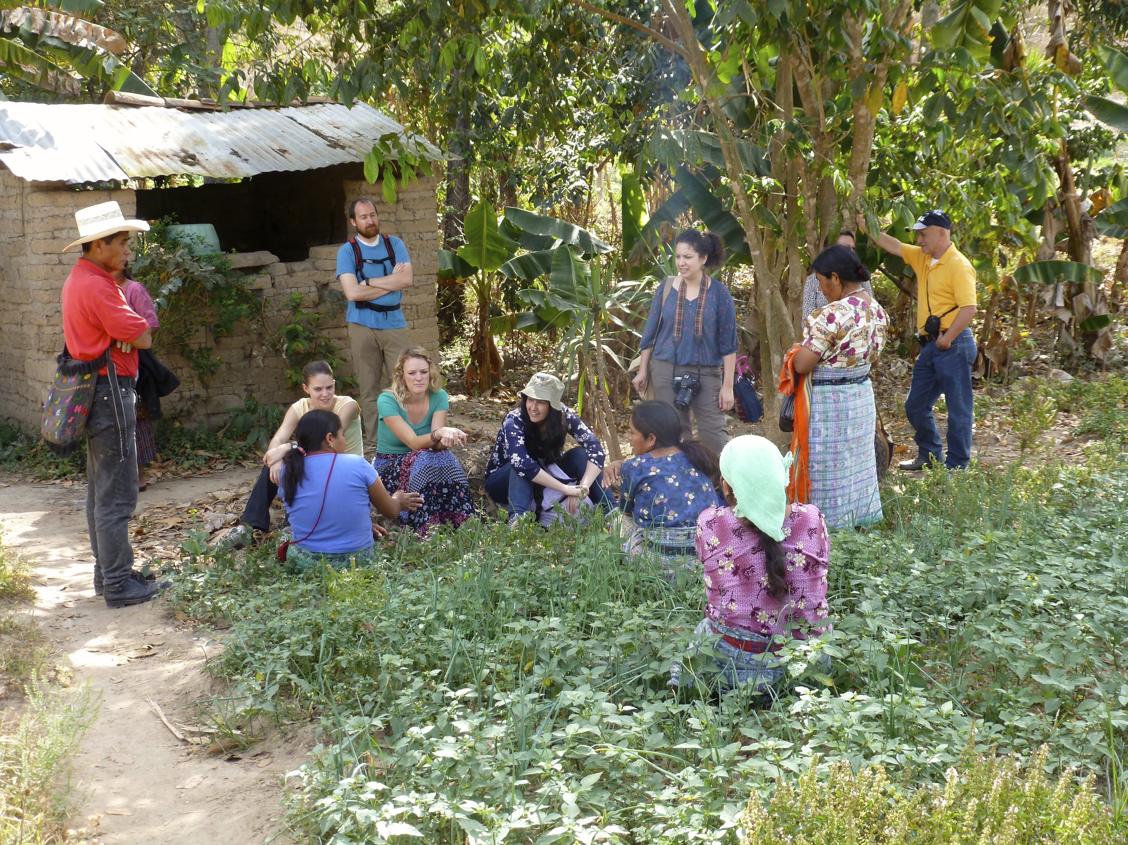
Goals For Today
Share what we learned in our travels
Share initial insights, emerging themes, and preliminary recommendations
Listen to CRS’ feedback, and discuss how we can deliver greatest value in our forthcoming reports

Slide 3
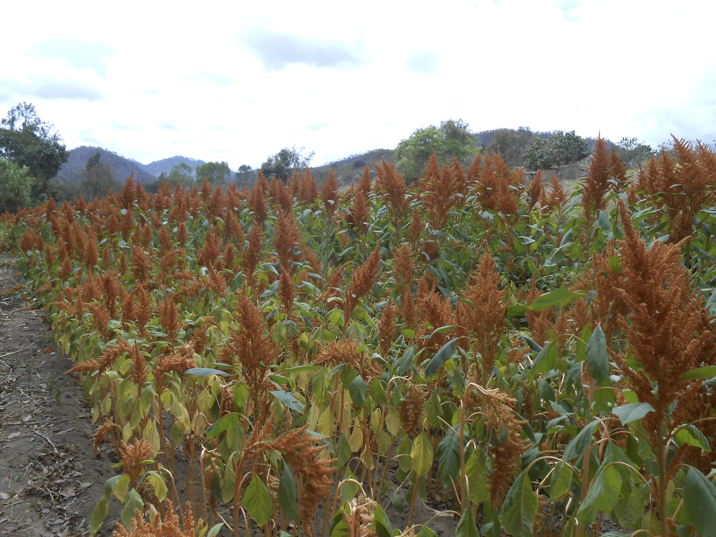
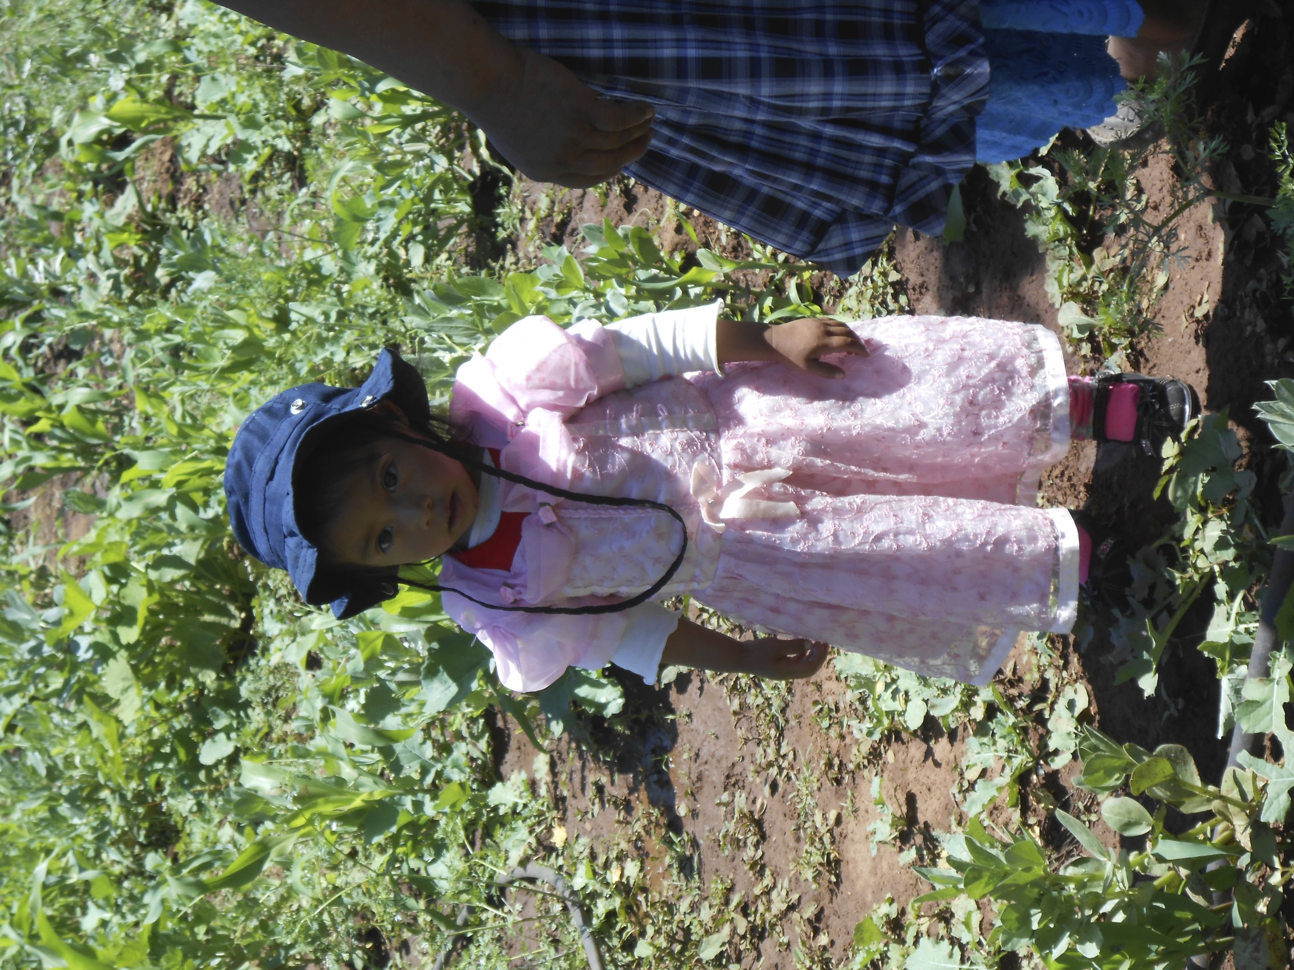
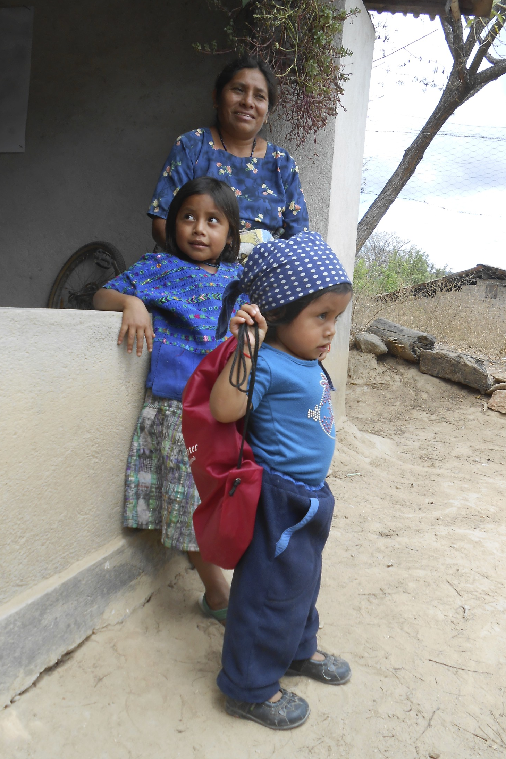
Problem Statement
How might CRS & their partners use amaranth to improve early childhood nutrition and livelihoods in Guatemalan subsistence farming families?

Slide 4
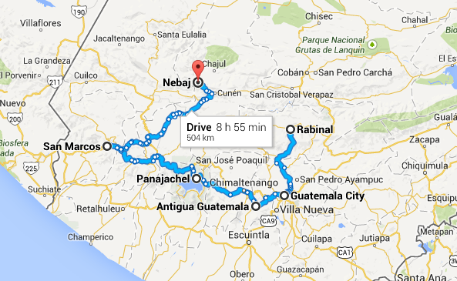
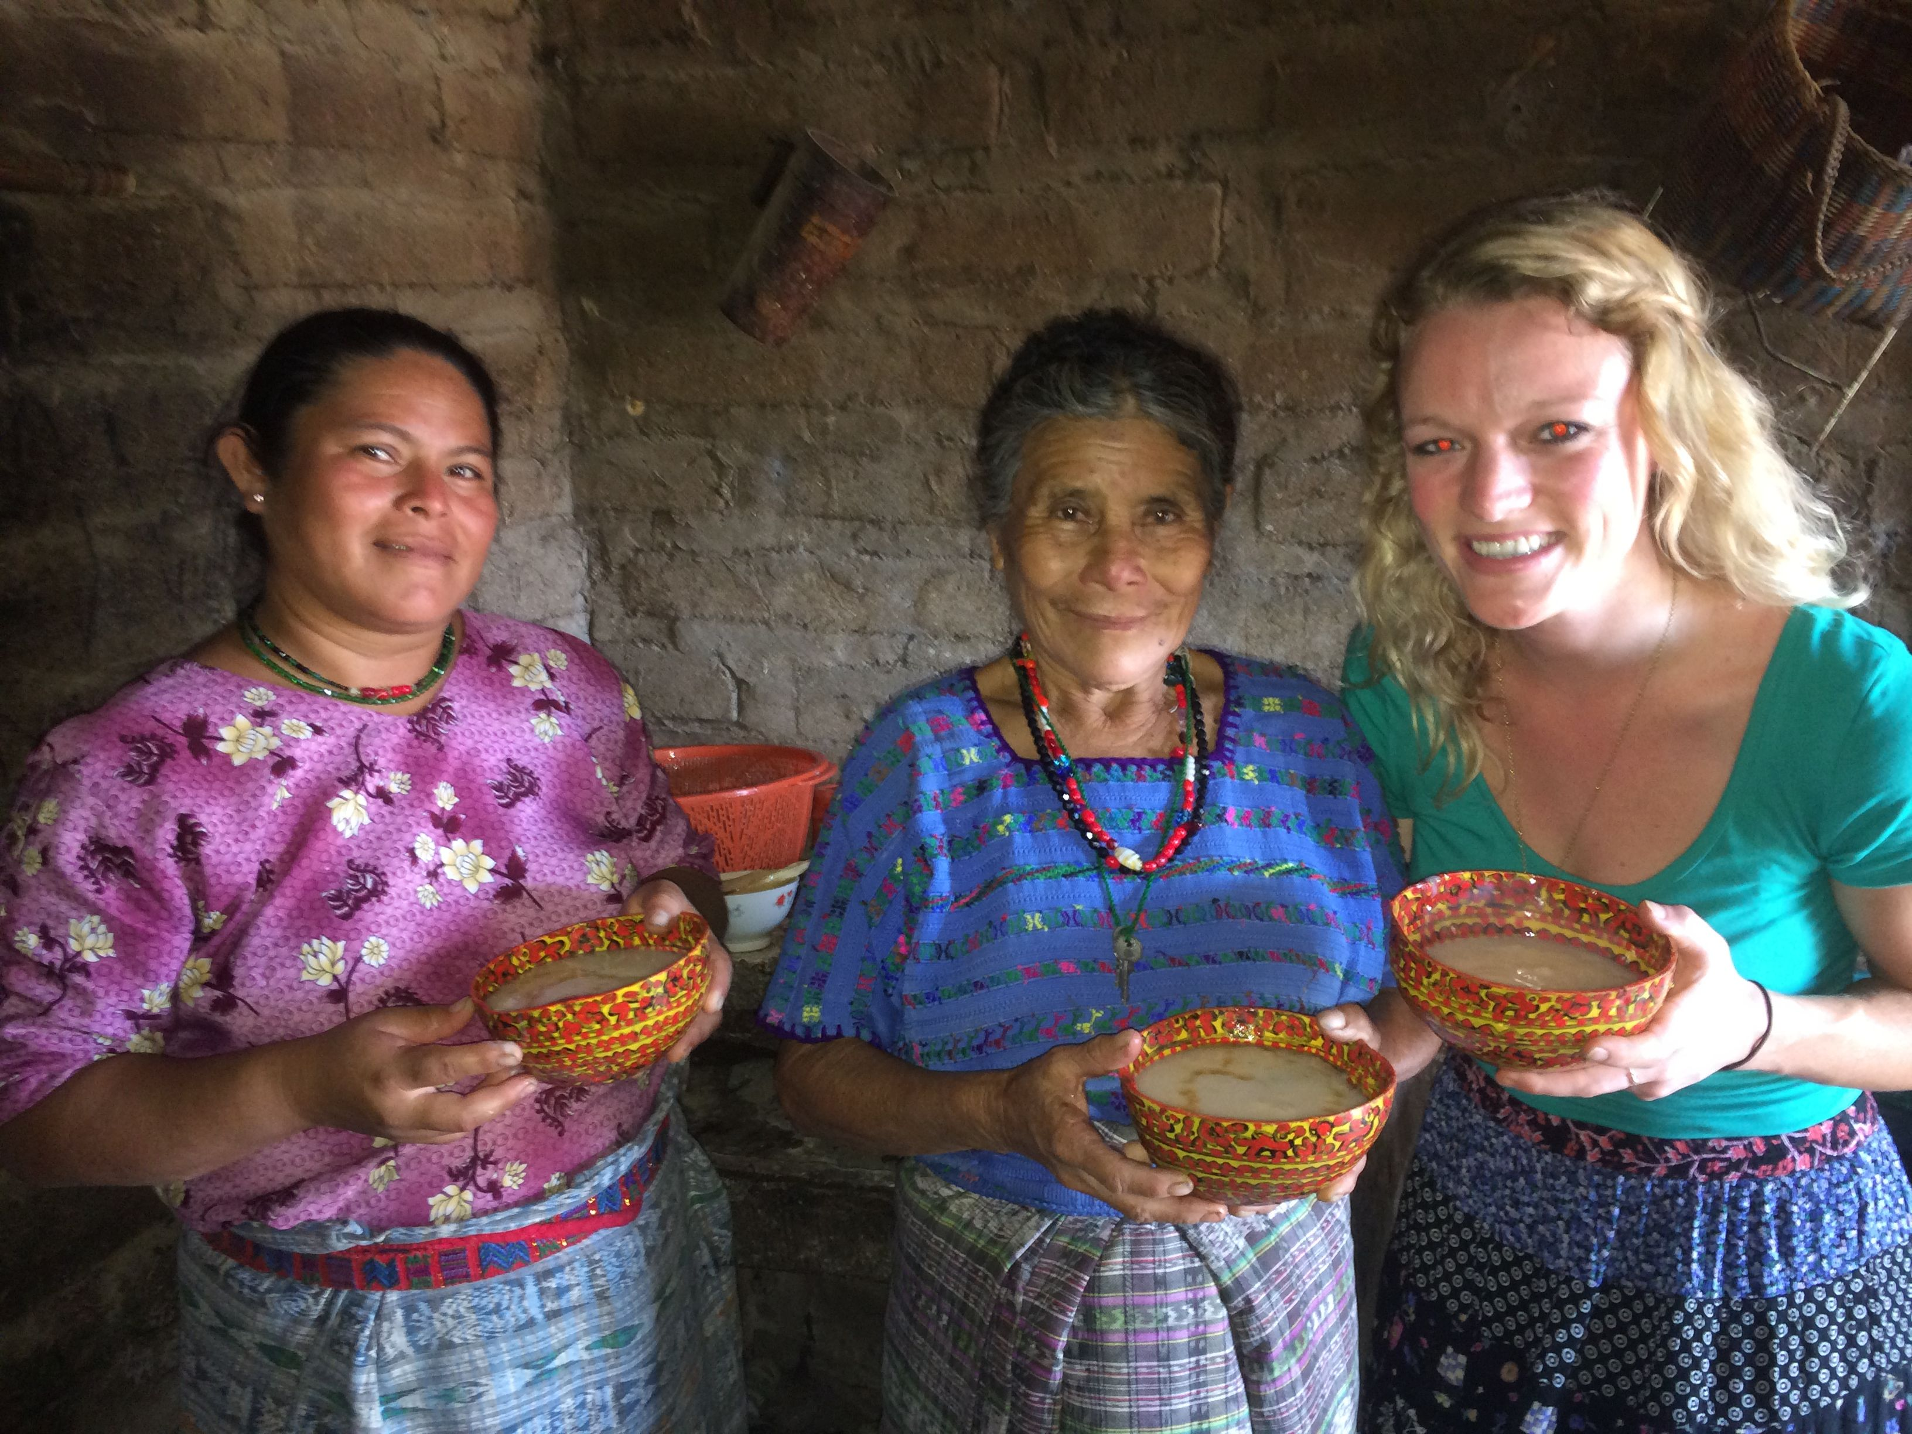
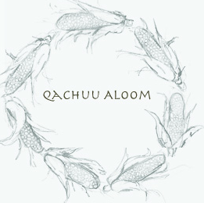

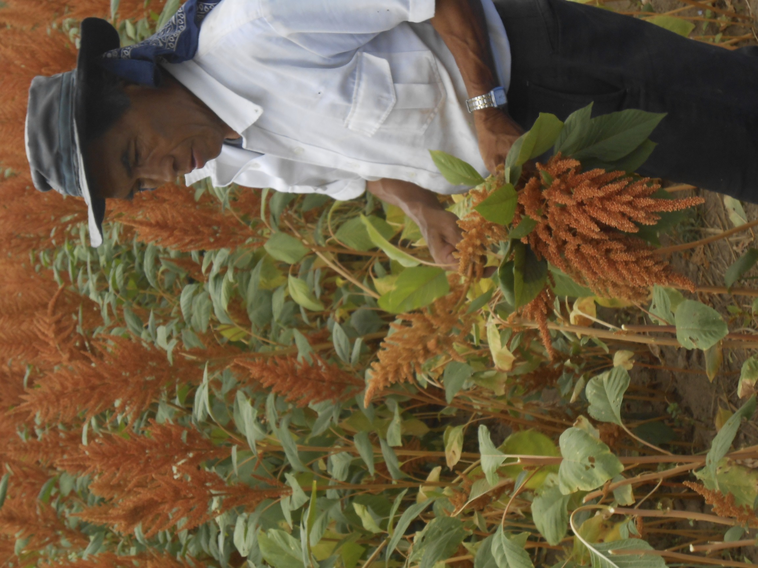
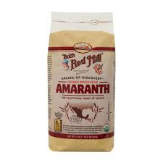
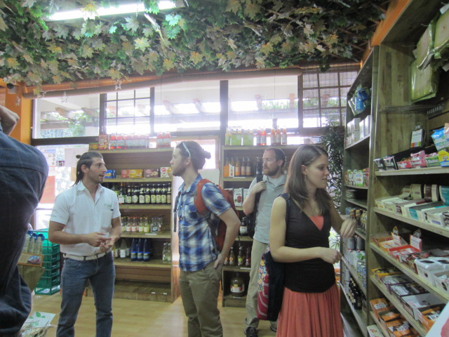
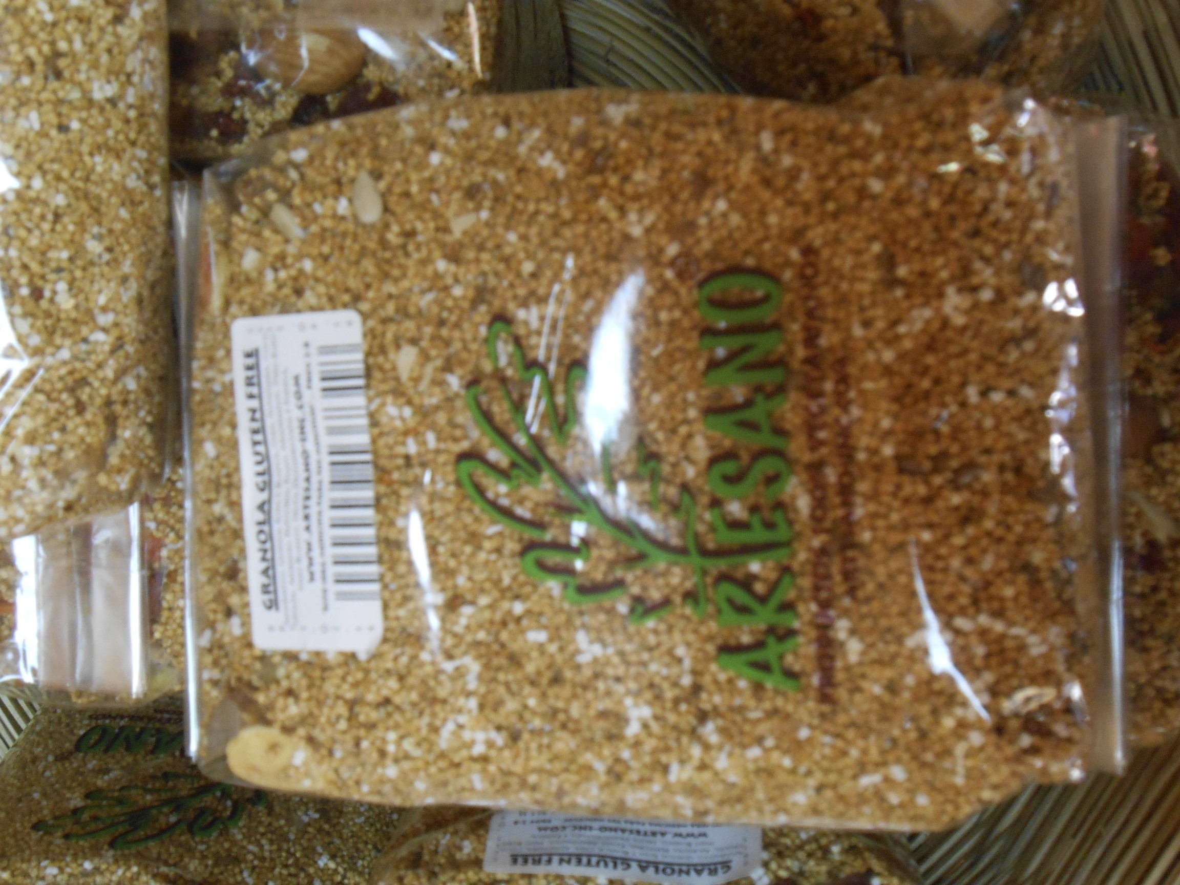

Our Approach:
GOALS: Understand Our Beneficiaries &
Trace the Guatemalan amaranth value chain
Families / Individual Consumption
Small Scale Farmers
Associations (Organizers)
Bulk Buyers (Local or Export)
Customers

Slide 5
Initial Findings
Conclusion #1
Amaranth is a viable intervention for addressing malnutrition and improving livelihoods
Conclusion #2
The critical factors are seed selection, technical training, dietary change and strong organizational structure.
Conclusion #3
The critical gap in the value chain is at the association/organizer level.
Conclusion #4
Significant value creation and capture can happen at the association/organizer level.

Slide 6
Initial Findings
Supporting amaranth cultivation in rural communities is a viable strategy to address malnutrition and improve standards of living, by forming the cornerstone of a nutrient-rich and economically attractive value chain.
Conclusion #1
Conclusion #2
The critical factors are seed selection, technical training, dietary change and strong organizational structure.
Conclusion #3
The critical gap in the value chain is at the association/organizer level.
Conclusion #4
Significant value creation and capture can happen at the association/organizer level.

Slide 7
Initial Findings
Conclusion #1
Amaranth is a viable intervention for addressing malnutrition and improving livelihoods
In the cases we examined, the factors most critical to the success of an amaranth project include seed selection & technical training, dietary behavioral change programs, strong organization led by well-trained leadership, and an eventual path to market.
Conclusion #2
Conclusion #3
The critical gap in the value chain is at the association/organizer level.
Conclusion #4
Significant value creation and capture can happen at the association/organizer level.

Slide 8
Initial Findings
Conclusion #1
Amaranth is a viable intervention for addressing malnutrition and improving livelihoods
Conclusion #2
The critical factors are seed selection, technical training, dietary change and strong organizational structure.
Our value chain analysis revealed a critical gap at the association/organizer level, which may prevent small farmers from accessing markets. We believe this is gap creates a clear opportunity for CRS intervention.
Conclusion #3
Conclusion #4
Significant value creation and capture can happen at the association/organizer level.

Slide 9
Initial Findings
Conclusion #1
Amaranth is a viable intervention for addressing malnutrition and improving livelihoods
Conclusion #2
The critical factors are seed selection, technical training, dietary change and strong organizational structure.
Conclusion #3
The critical gap in the value chain is at the association/organizer level.
Significant value creation & capture happens at the association/organizer level of the value chain. After farmers have been successfully connected to markets, a good next step would be supporting them to move further up the value chain into these value-added activities.
Conclusion #4

Slide 10

Nuestro Viaje

Slide 11
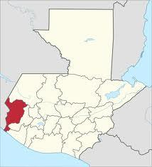
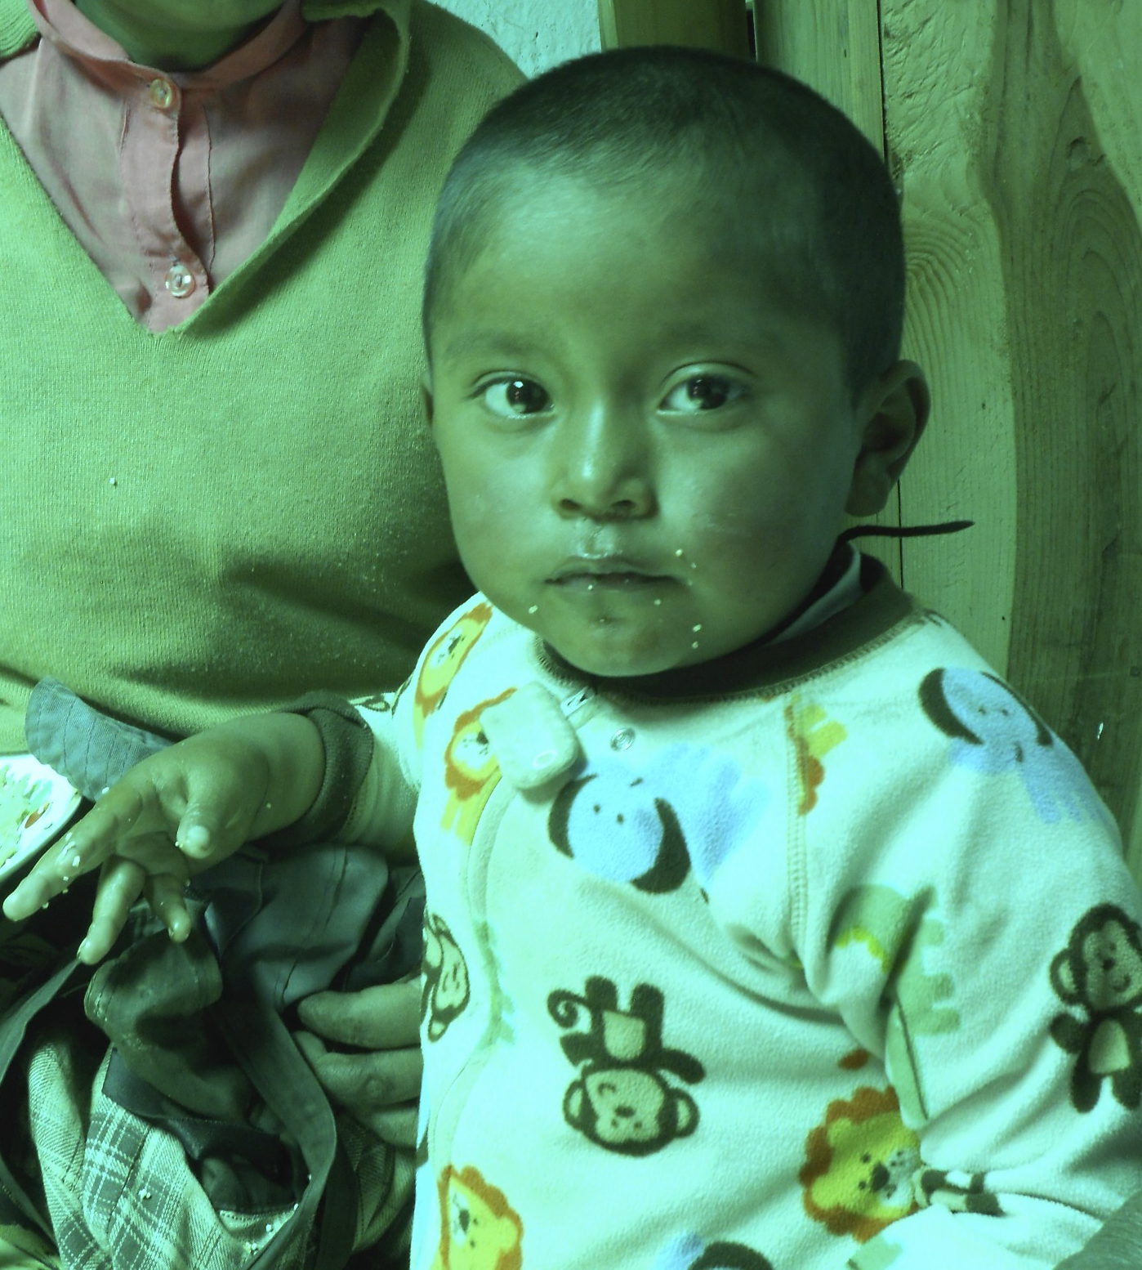
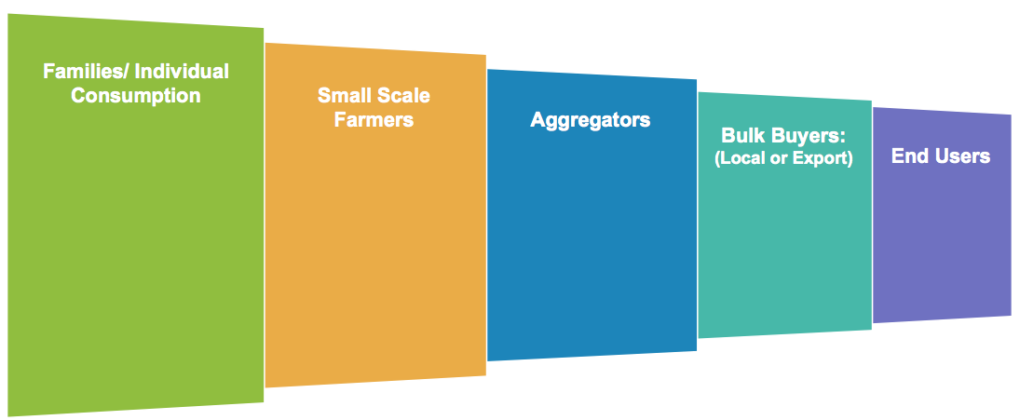
Families & Individual Consumption
Guiding Questions:
Who are the people CRS serves?
Will they eat amaranth? Buy it? Value it?
What are best practices for behavior change?
Where have other efforts succeeded & failed?
San Marcos Stats
85% live in poverty or extreme poverty
70% malnutrition rate (WFP) - highest rate in Latin America, among children under five (Oxfam)
History of violence

Slide 12

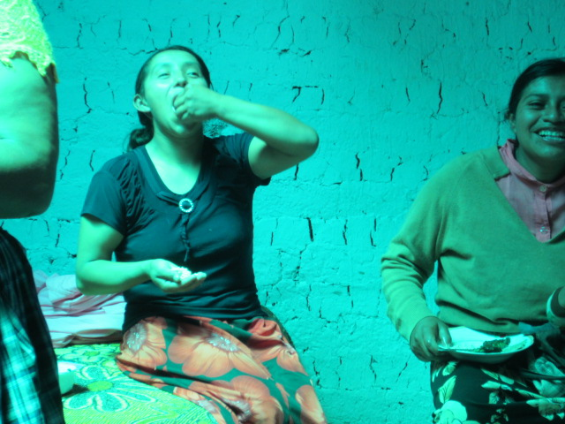
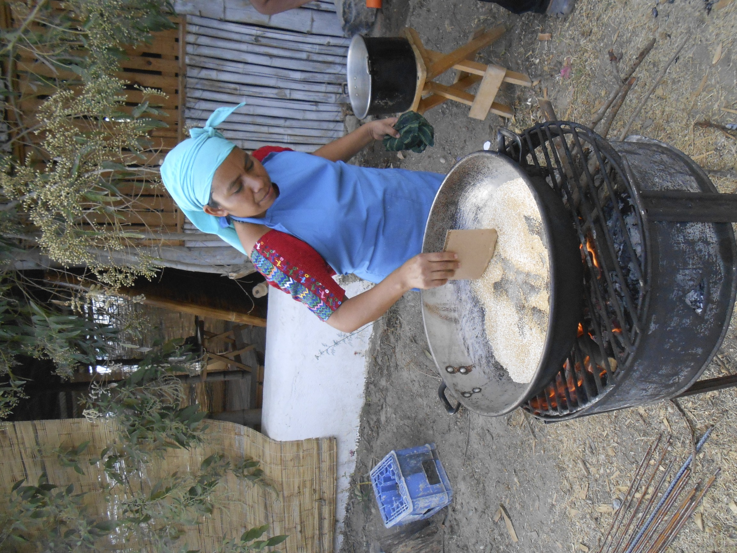
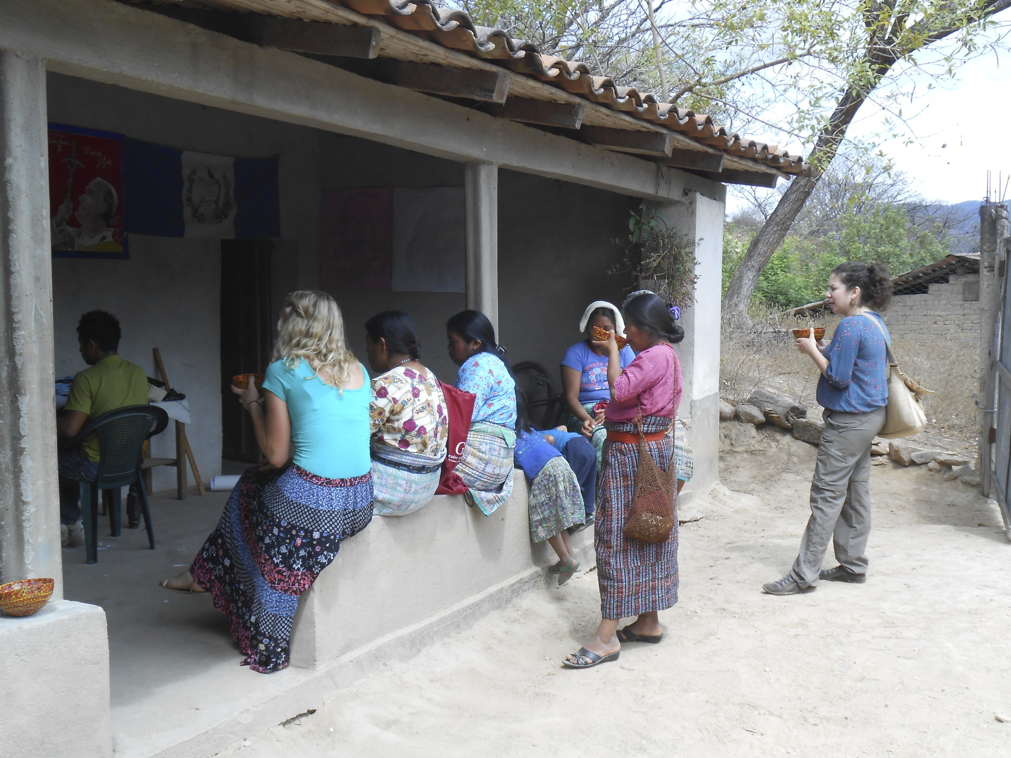
Kitchen Conversations
Head of Households Interviewed: 12
Meals Shared: 6
Cooking Lessons: 4
Alegria Field Testings: 3
“ This Alegria is so good – people would buy this. Well, they would if they had money”

Slide 13
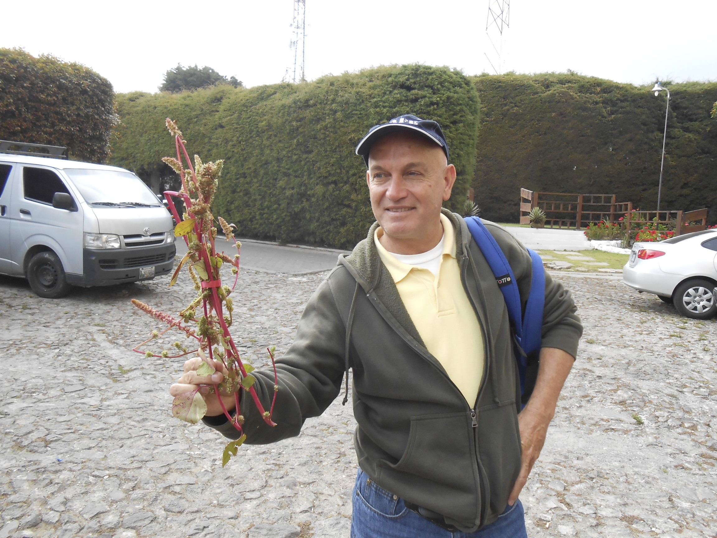
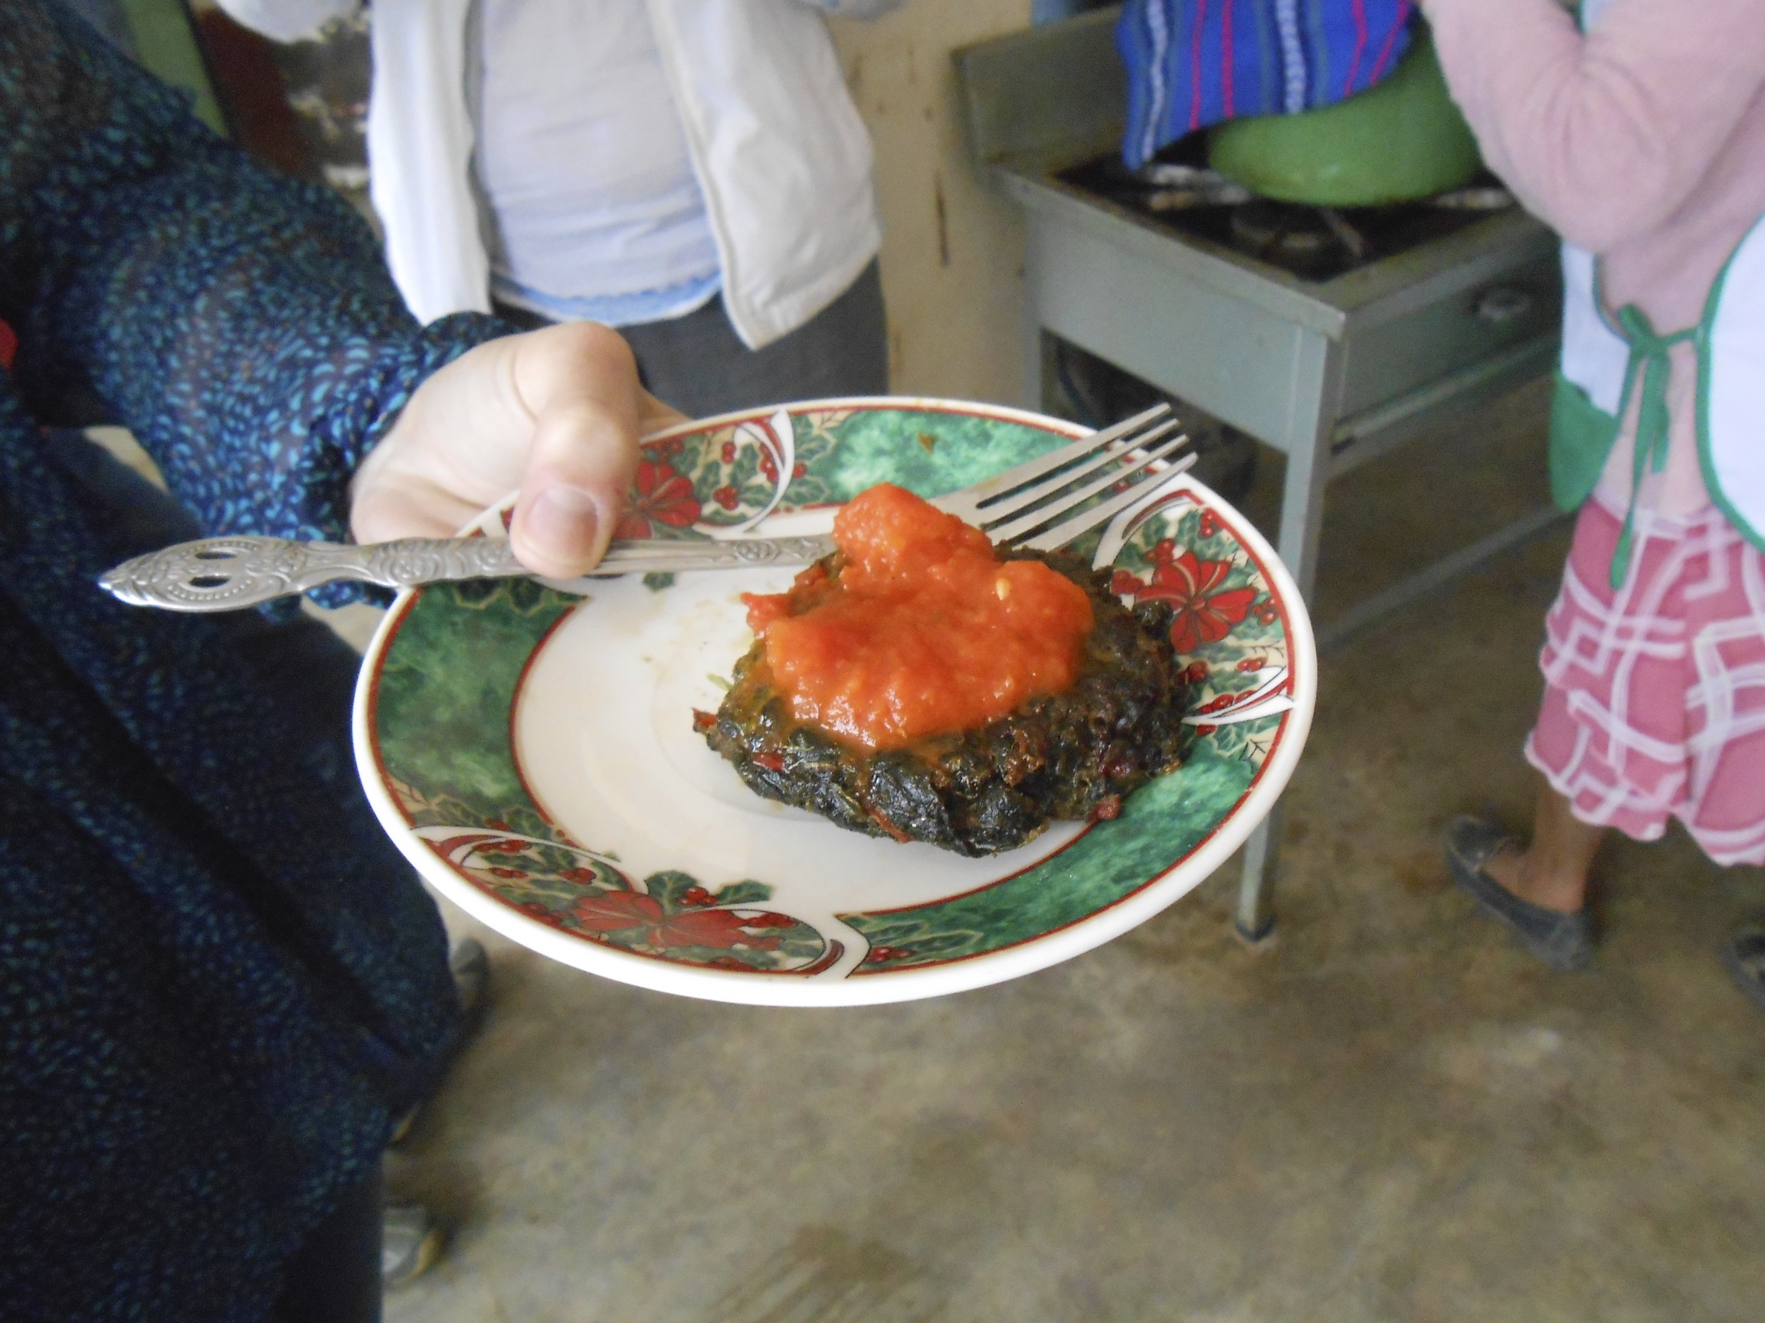
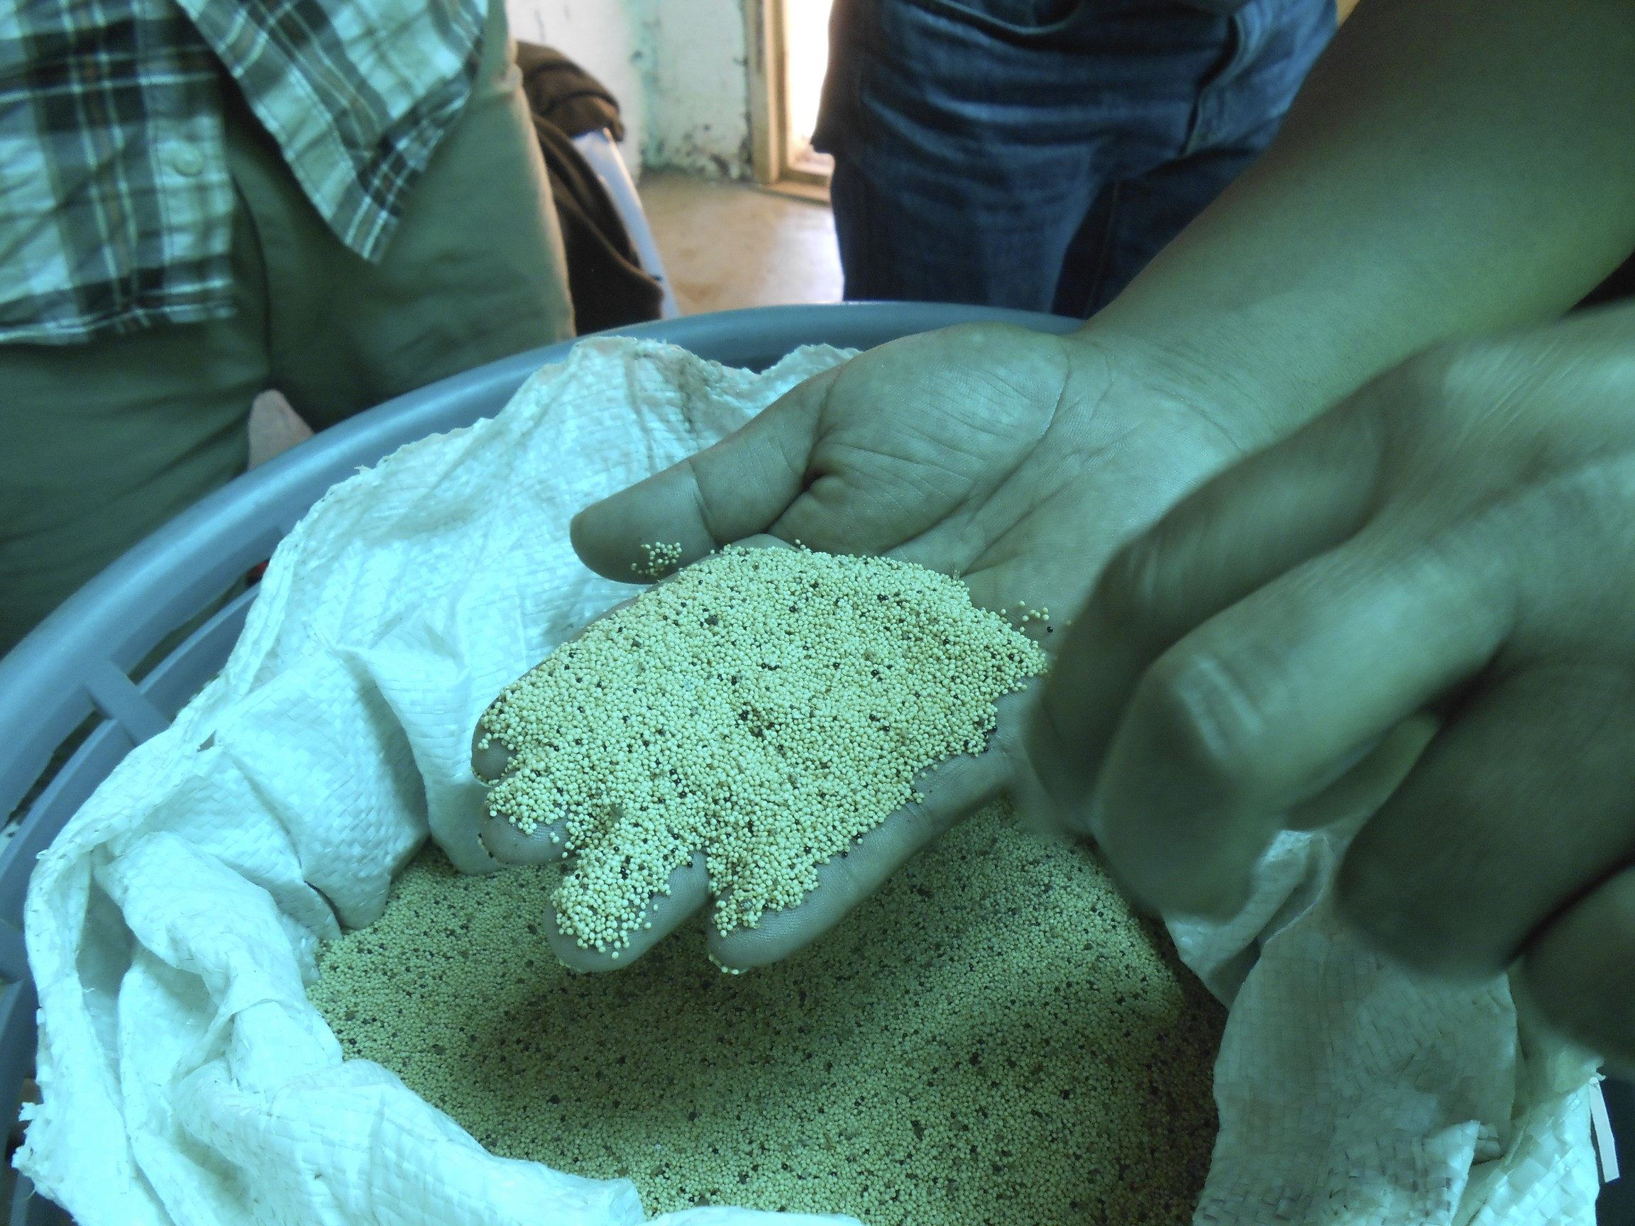
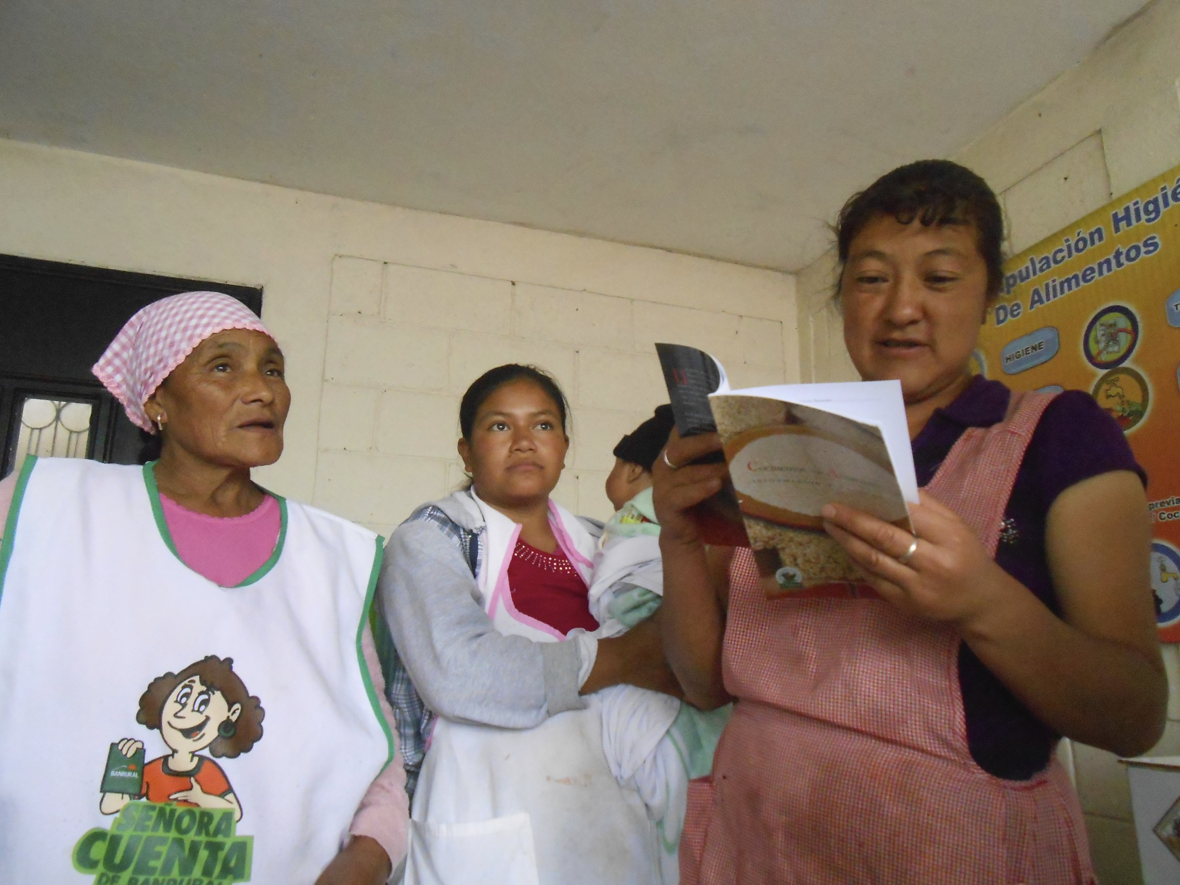
Amaranth in the Diet
Findings:
A suboptimal Amaranth varietal is already grown & eaten, as “BLEDO” Introduction of better amaranth would provide both BLEDO + Semillas
Among subjects who currently grow grain amaranth, many were unaware
of preparation methods beyond Atole – but they want to learn!
Low-Quality Bledo Amaranth
Torta de Bledo
“It was just sitting there so a rat ate it”
“We won’t let you leave without sharing these recipes!”

Slide 14
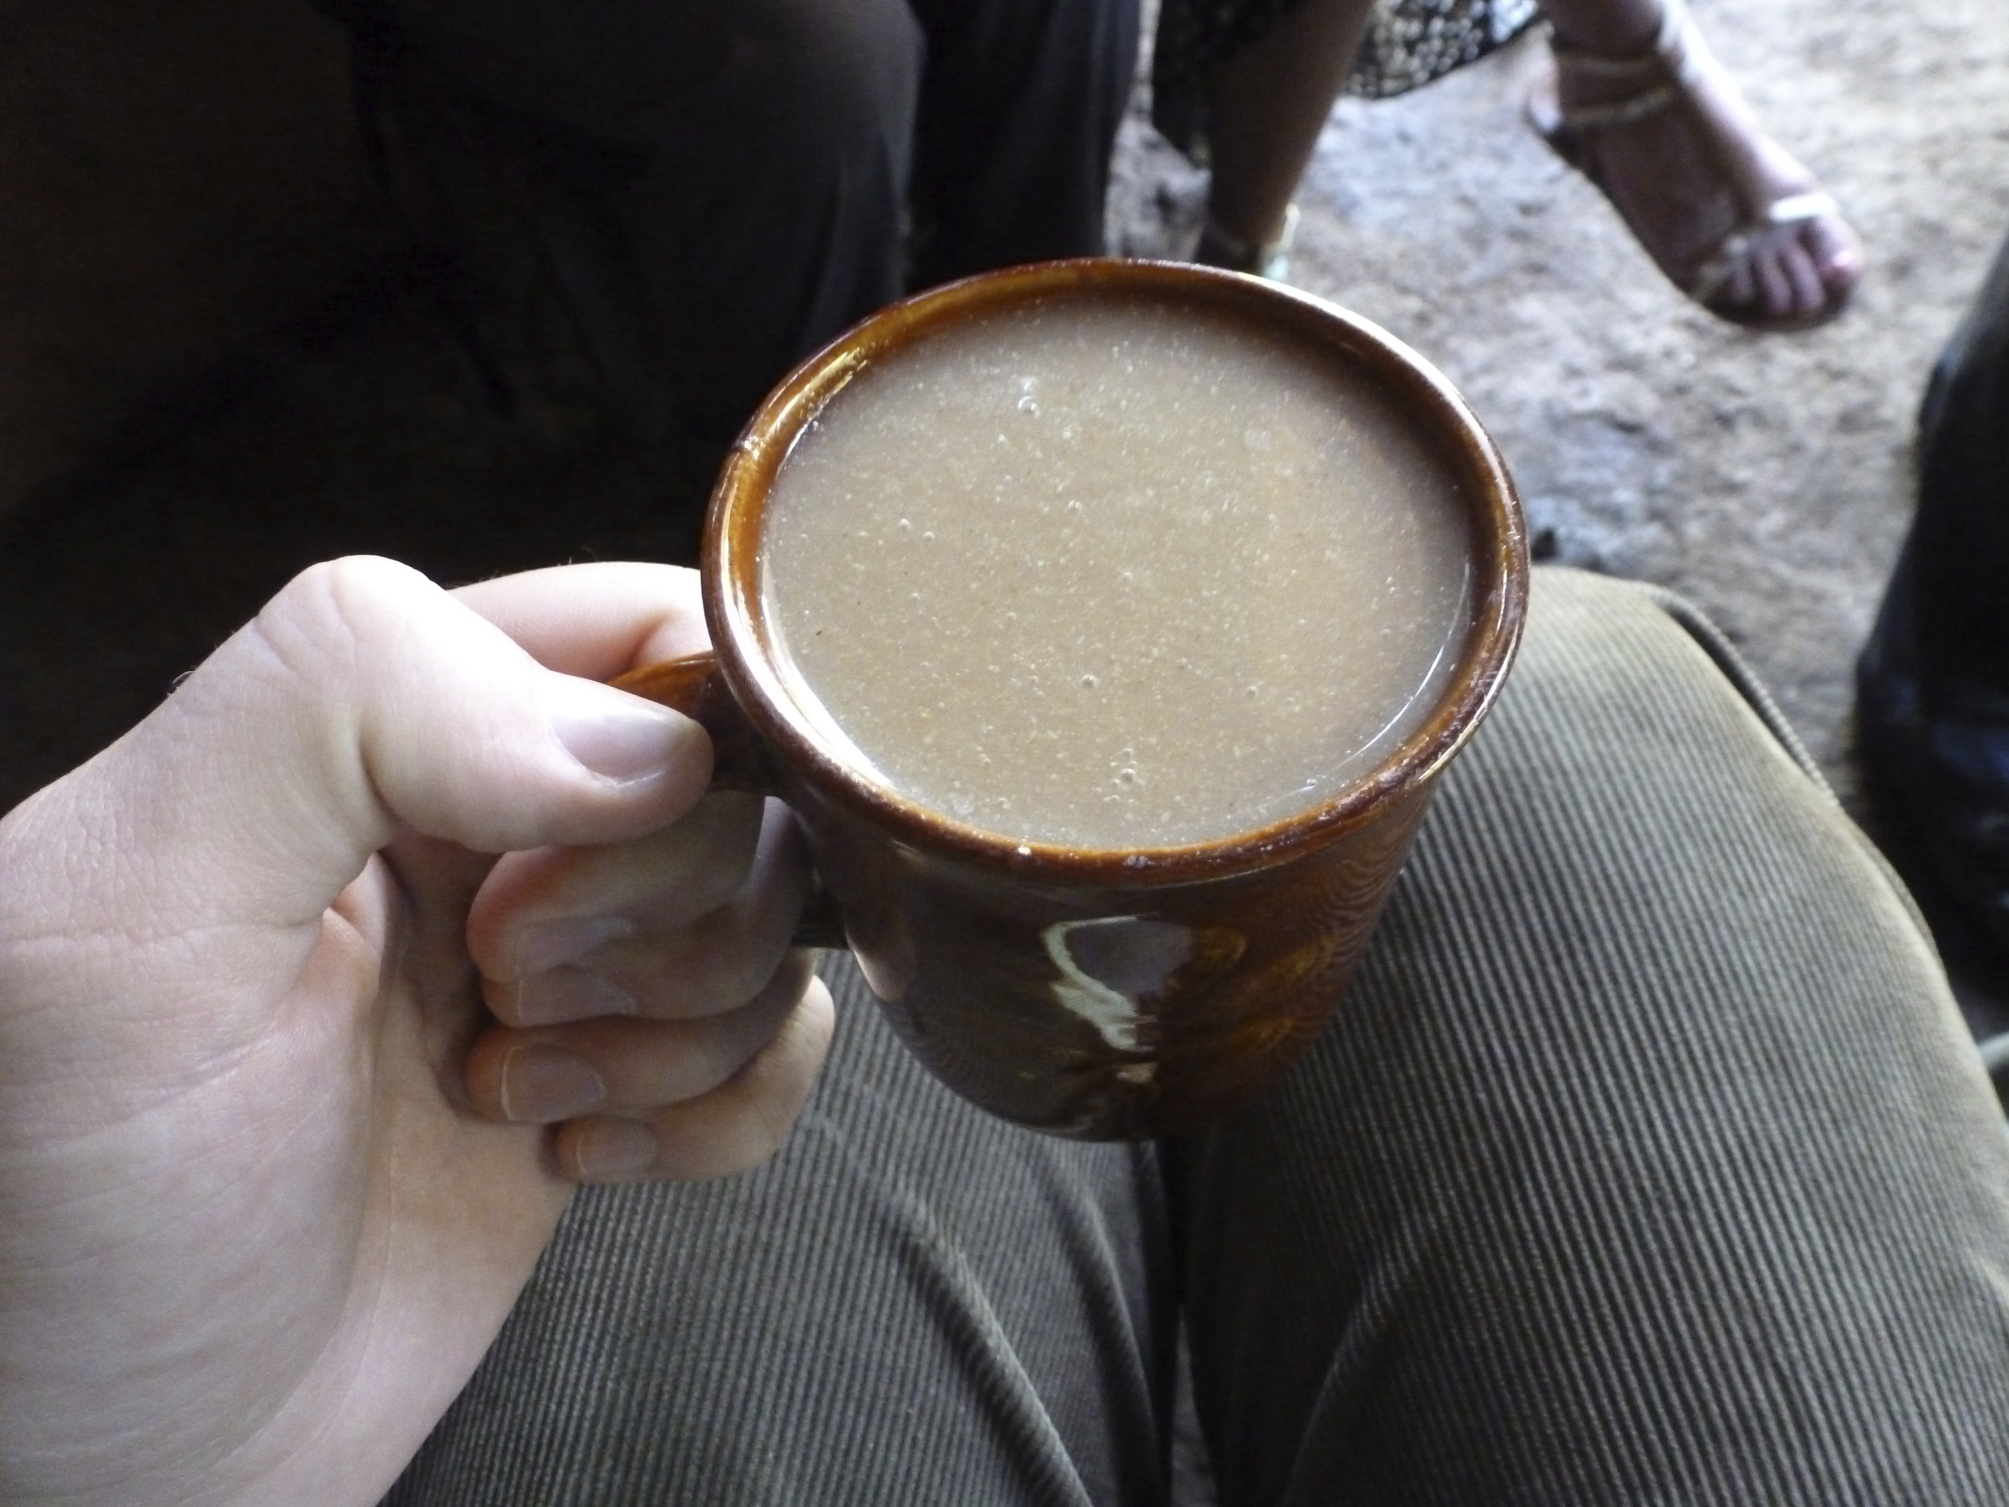
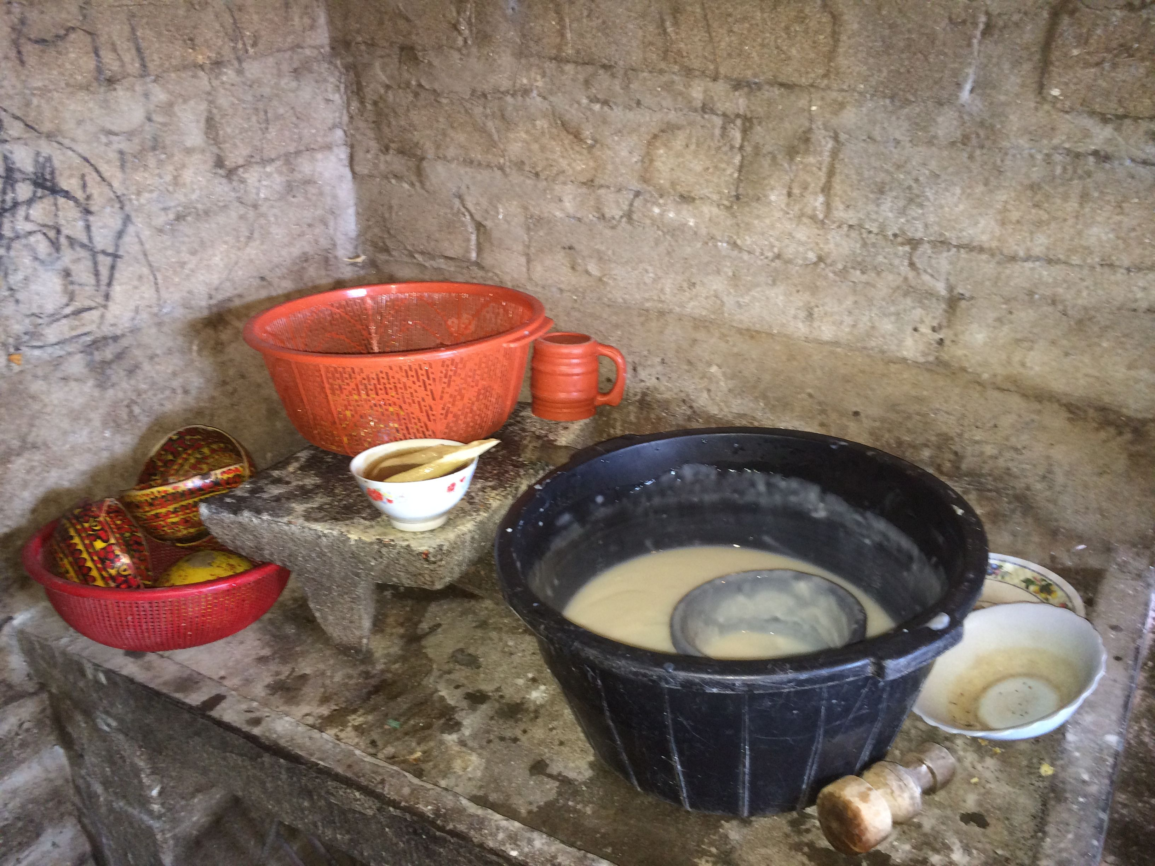
The Nutritional Benefits of Amaranth
A study in Mexico demonstrated:
13g of amaranth per day reduced 75% of mild-moderate child malnutrition
23g of amaranth per day is needed to reduce severe malnutrition
Typical Daily Menu
Breakfast: Beans, tortillas, coffee
With or Between Meals: Atole
Lunch: Soups, beans, tortillas, vegetables
Dinner: Beans, tortillas, tortilla-coffee
Once Per Week: Meat or eggs

Slide 15
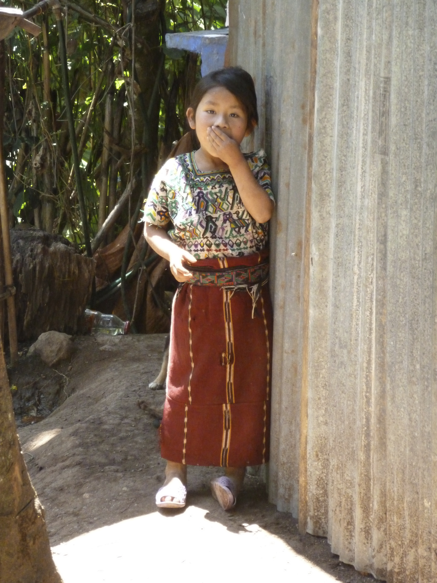
Key Take-Aways: Family Level
On Consumption & Recipes:
The easiest point of introduction for amaranth is Atole
The amaranth plant has two dietary uses – the grain and the leaves (Bledo). This is of interest to growers due to non-simultaneous harvesting.
Above a 50/50 corn mix, amaranth changes the texture (stickiness) of tortillas: 25% Amaranth is the ideal proportion to preserve flavor and texture
Poporopo (popped amaranth) is easy to make and loved by children
Most subjects were unexposed to Alegria but were very excited about it.
On Program Implementation:
People are generally open to amaranth adoption but lasting dietary change is the challenge. Cooking contests and demonstration kitchens have had success.
The cultural connection to amaranth is attractive to persons who identify as Mayan.

Slide 16
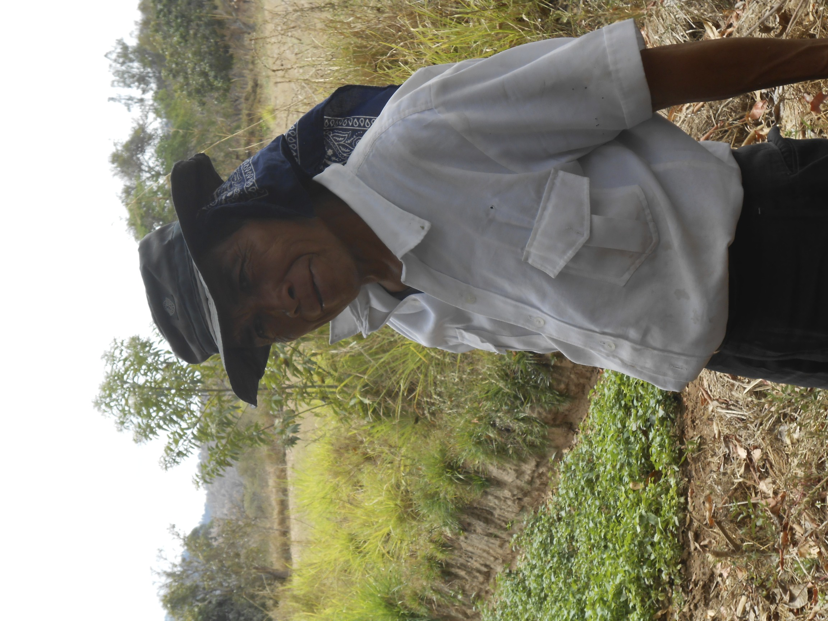
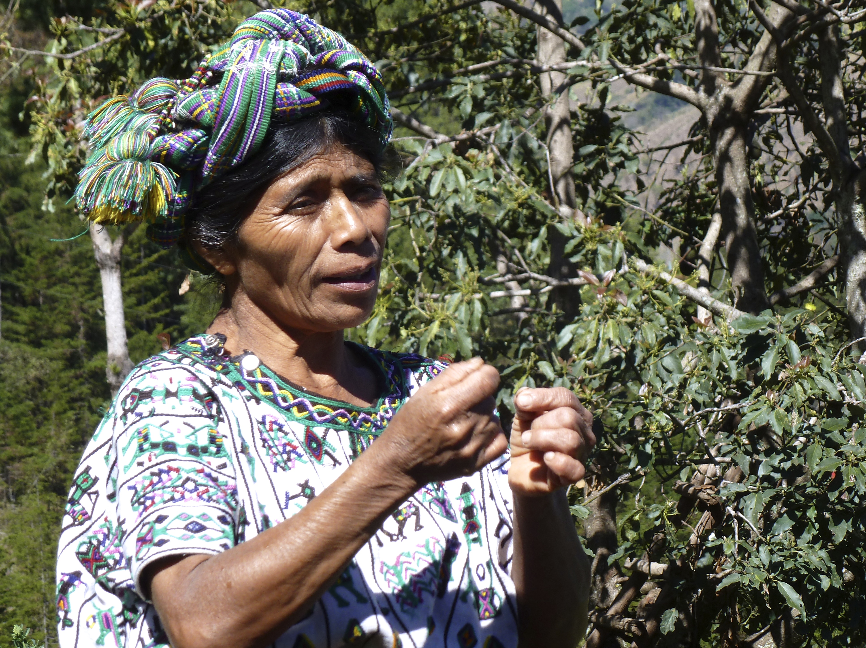
Small-Scale Farmers
Guiding Questions:
What are the economics of growing amaranth?
Are farmers willing to take the risk?
How similar is amaranth production to corn production? How much training is required?
Will amaranth grow well in the Western Highlands?
Farms Visited: 8
Number Growing Grain Amaranth: 7
Number Consuming Amaranth or Bledo: 8
Number Participating in Markets: 7
Annual Harvests: Regionally Varied

Slide 17
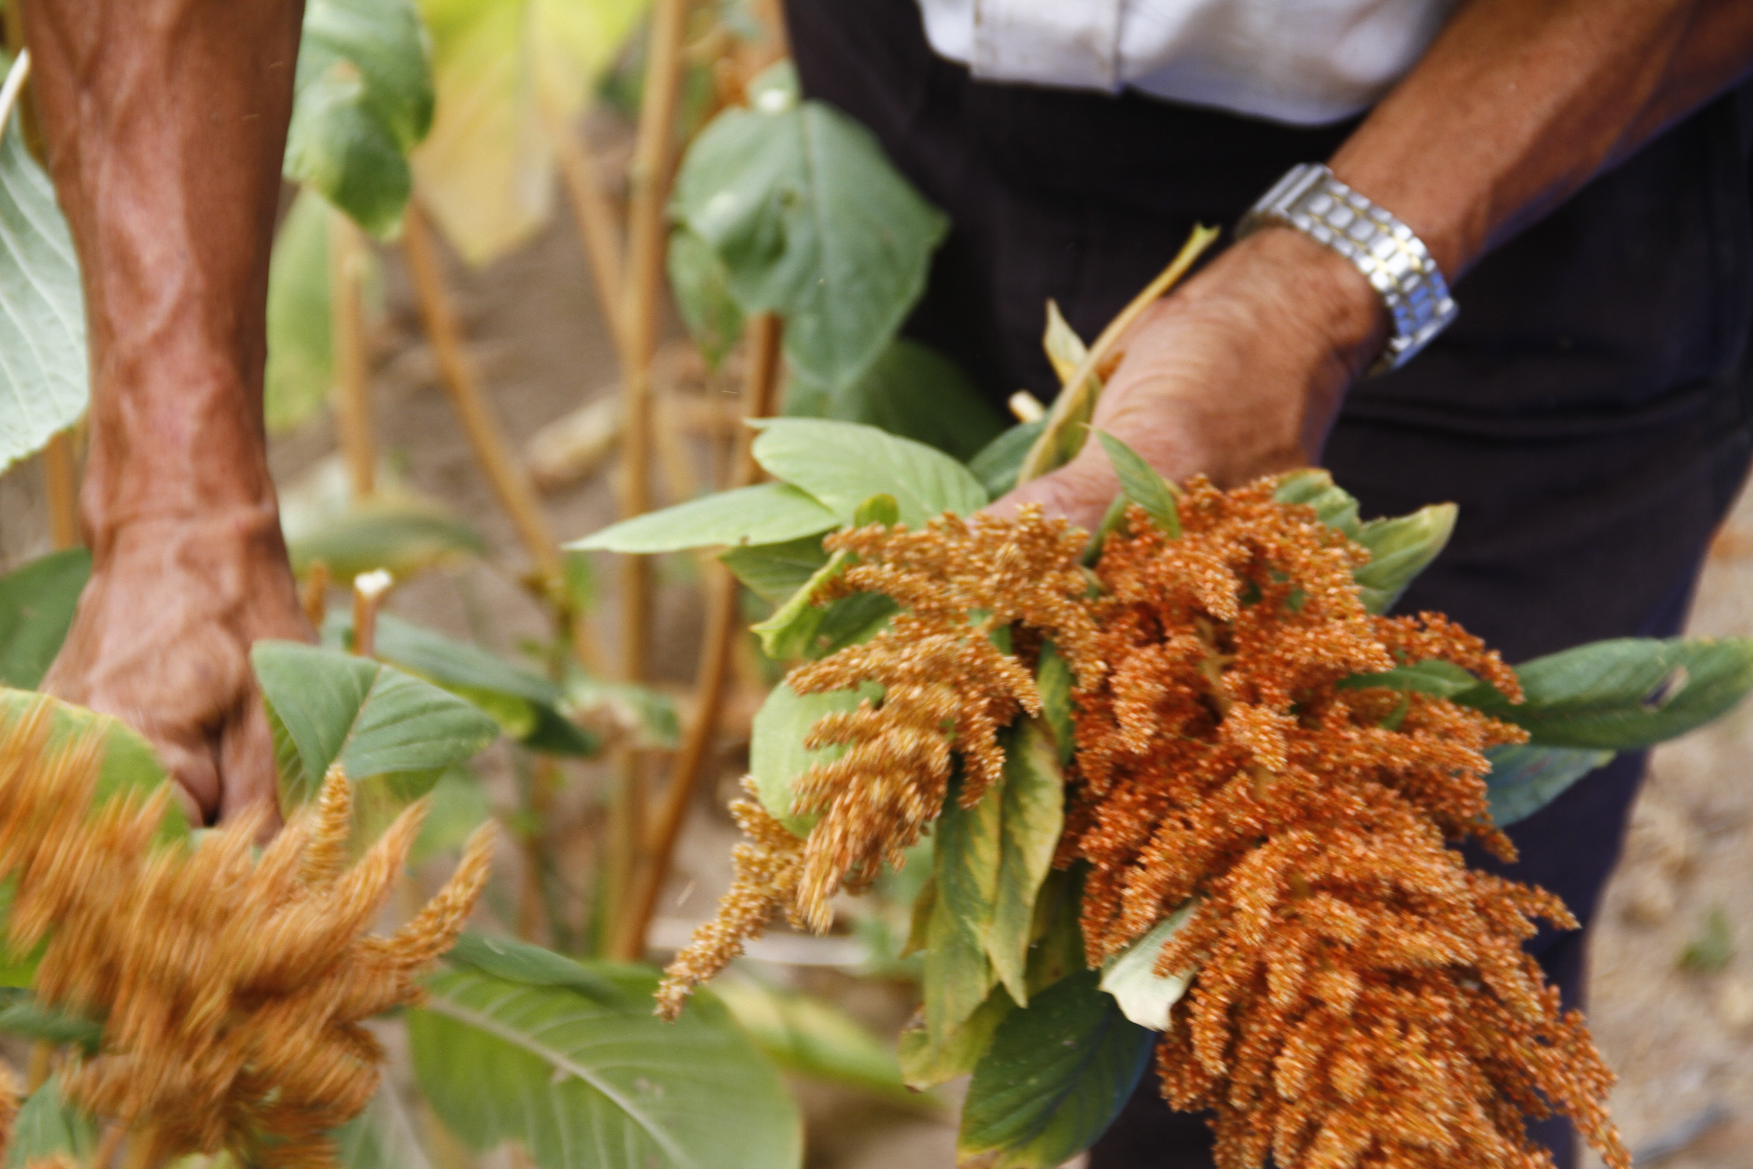
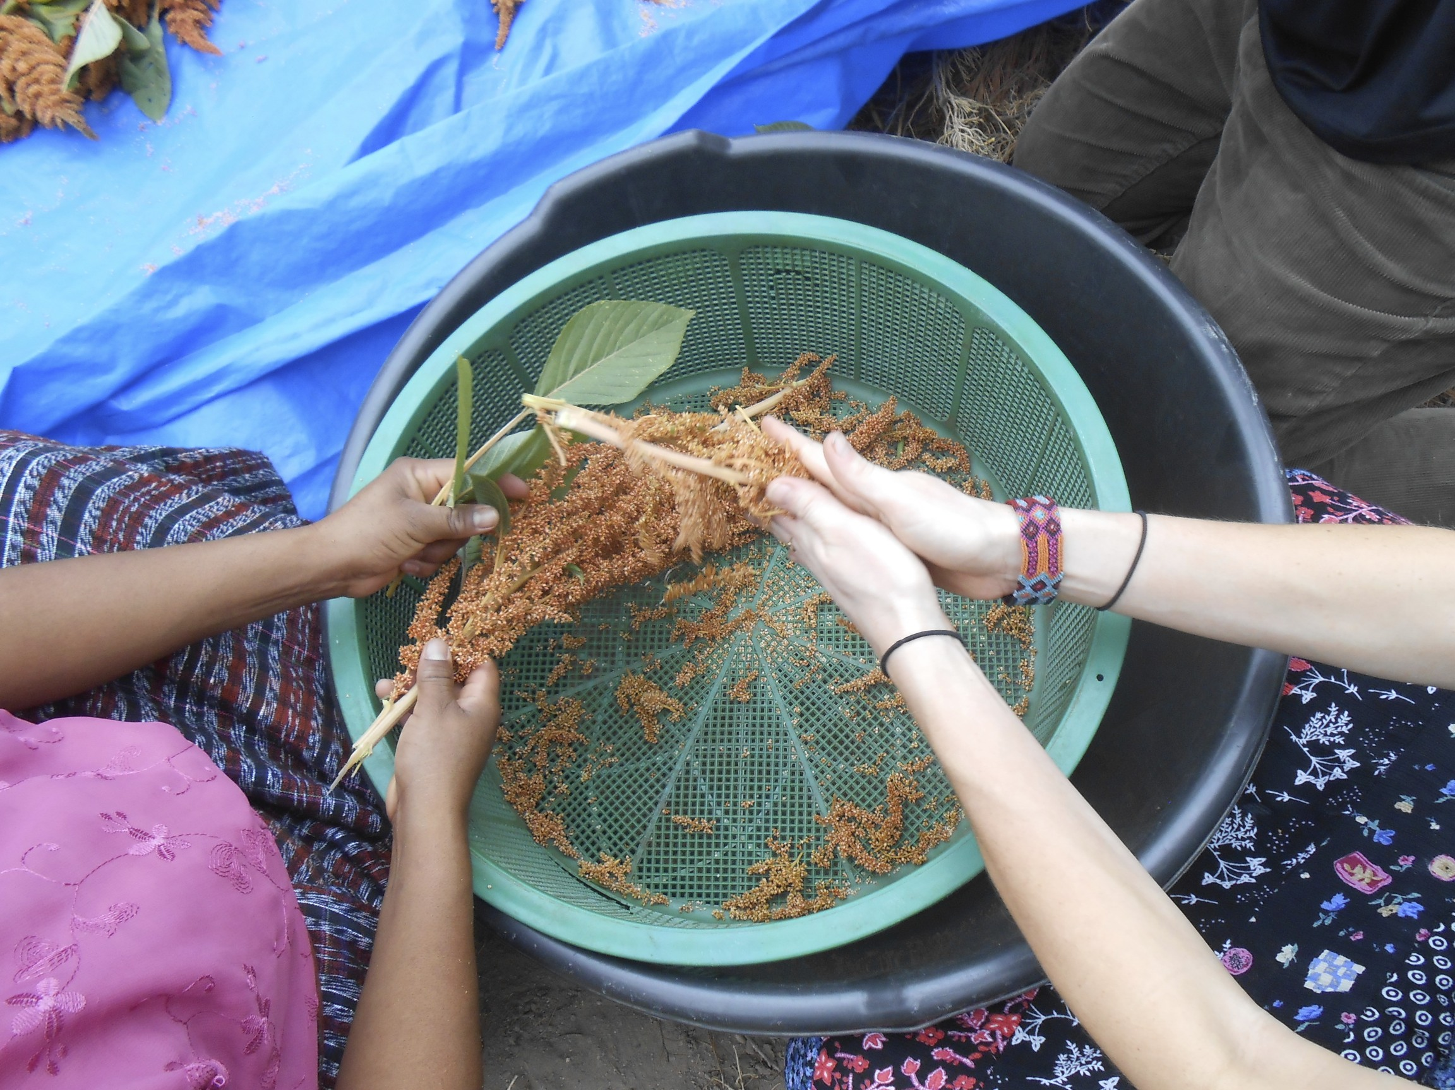
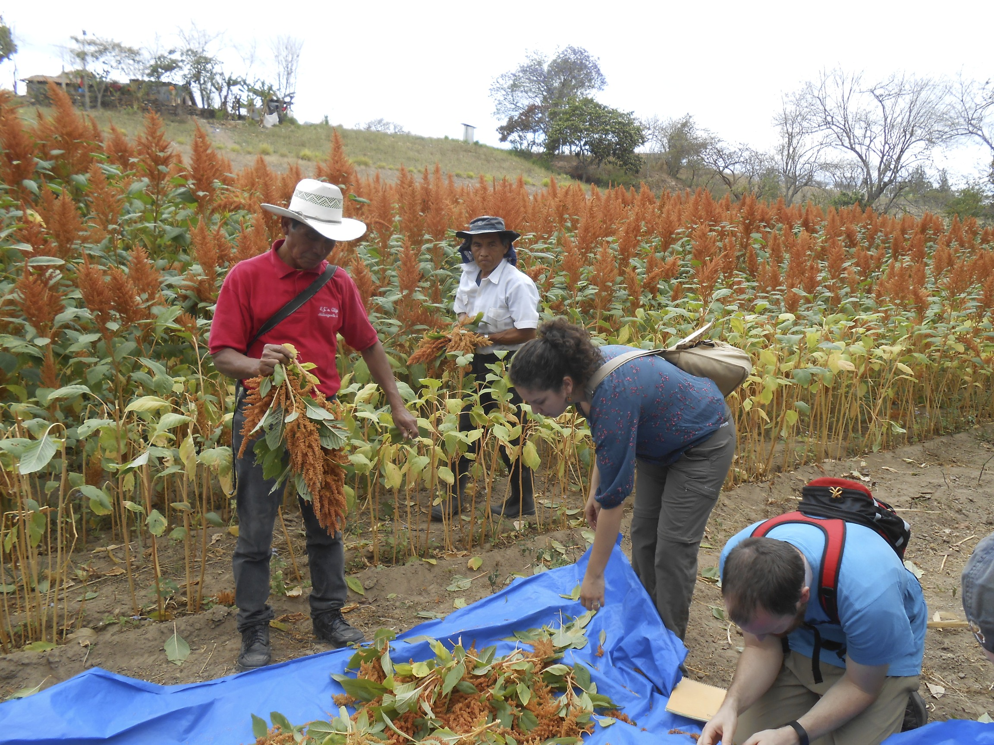
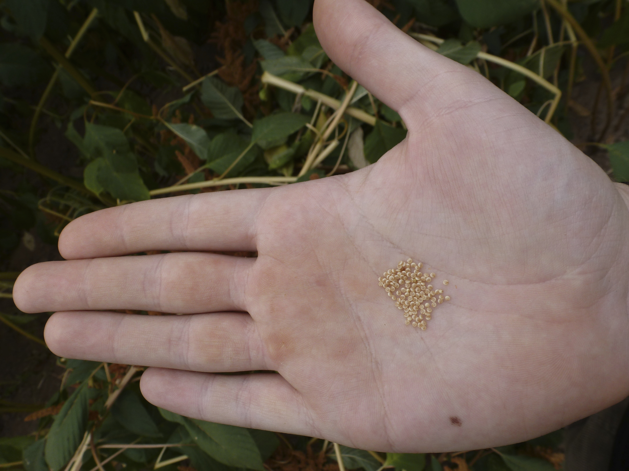
Harvesting Amaranth
Amaranth heads are snapped from the stalk (larger plants require cutting tools).
Seeds are released by rubbing between hands. Debris is captured in
strainer.
Heads are collected in a pile and leaves are removed.
Seeds are ready for
processing.
The typical amaranth harvest requires and average of 5 days per cuerda, which is comparatively more than corn.

Slide 18
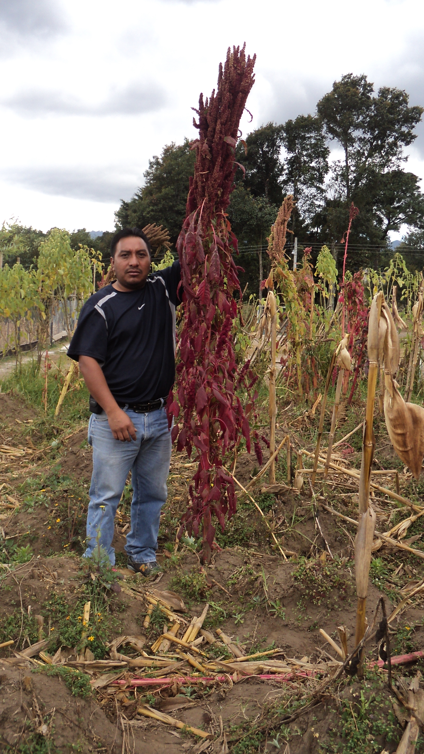
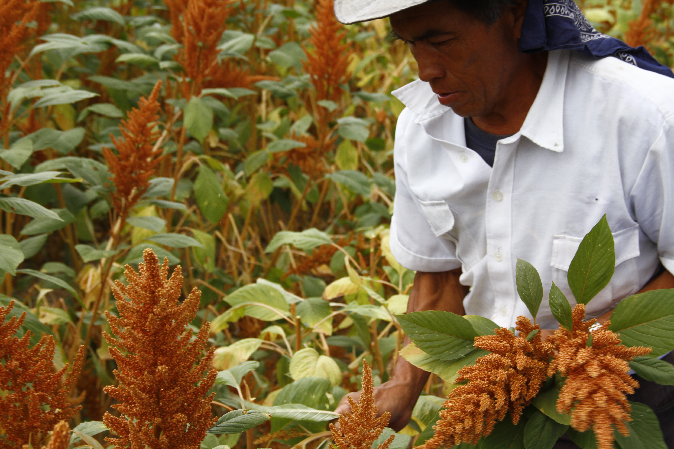
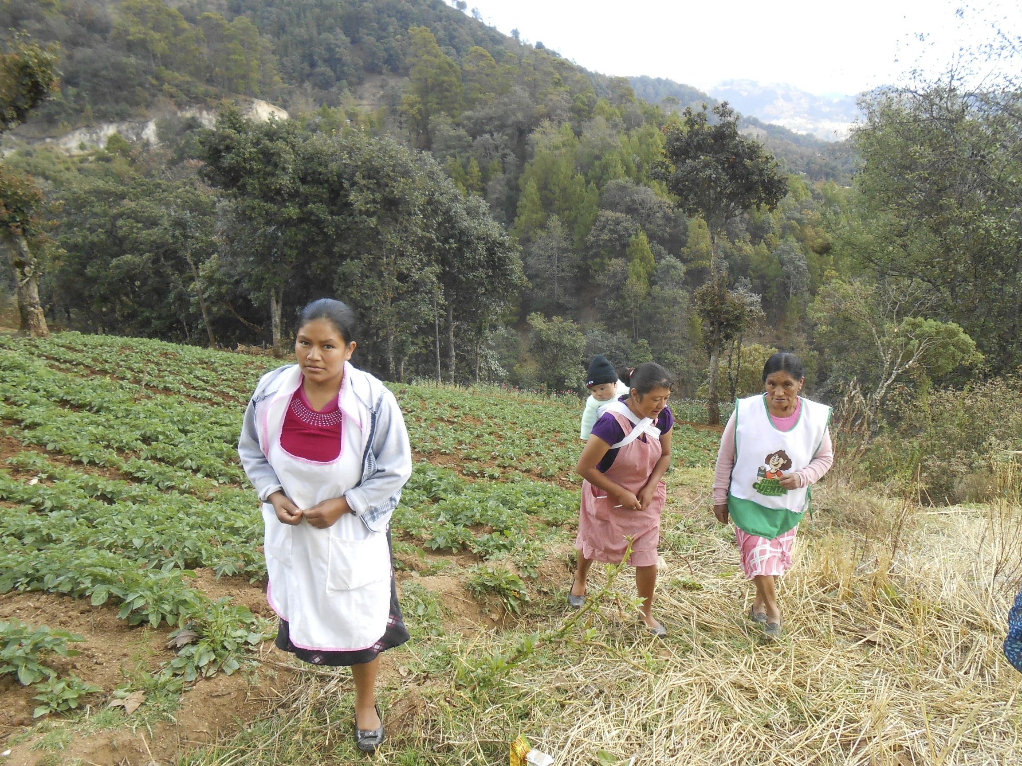
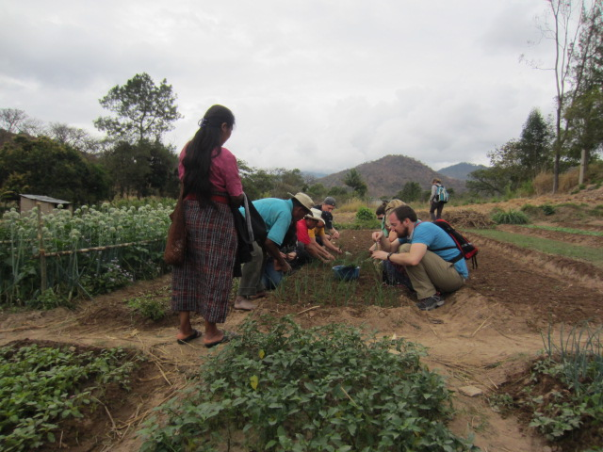
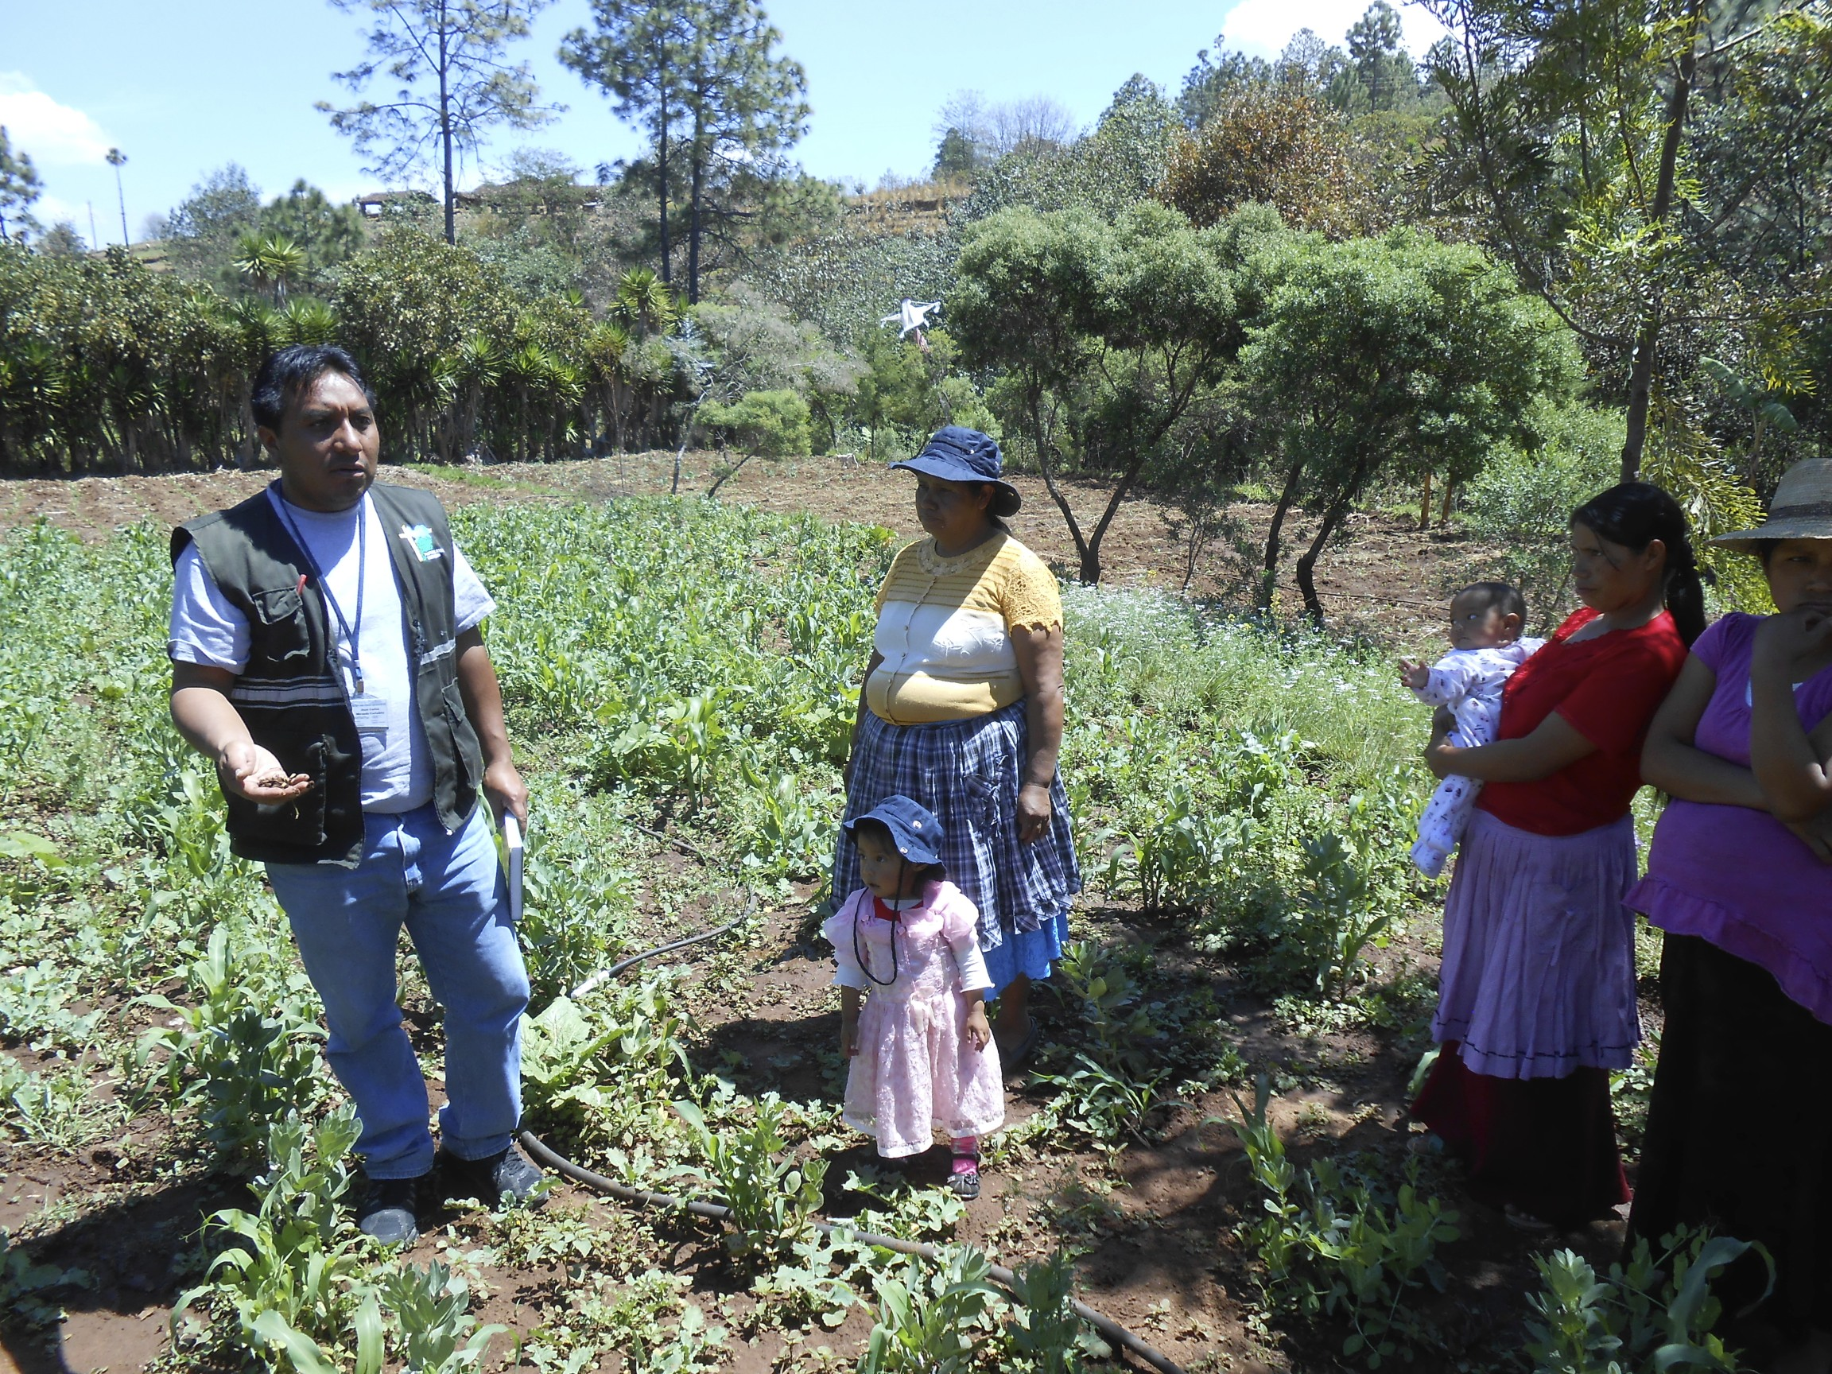
Talking Shop
“I alternate growing corn & amaranth, according to seasons”
“Our Amaranth got the plague and Intervida was no longer around to help. So we just stopped growing it.”
“I buy my seeds from California -
that’s why my plants
grow so large”
“We don’t usually have much surplus but we do sell a few baskets to the association”

Slide 19
Economics of Small Scale Farms
Primary input costs are fertilizer & seeds
Cost structure similar to corn but with 3X more income potential
Typical crop consumption rate 50% – 80%
Must recognize opportunity cost of additional labor cost for amaranth
Average Production Costs
30Q – 150Q per qq
Farmer Sale Price
800Q - 1200Q per qq

Slide 20
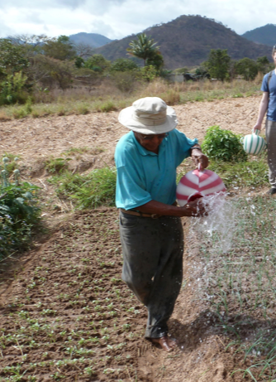
Key Take-Aways: Small-Scale Farmers
On Cultivation:
Seeds are everything – many people had strong personal beliefs about seeds (Chikach – in house, Rabinal – heritage & independence, Juan Carlos – US)
San Marcos has a great diversity of agronomic conditions, requiring adaptations
Diversification is key – amaranth can be a core building block of a diversified farm
On Farmer Interest:
Farmers are interested in becoming self-sufficient
Farmers are willing take a risk but they need to see the potential rewards
(know how to reach markets, understand health benefits)
3. Associations & others have had success introducing & training on amaranth
**A key need is for someone to aggregate small scale producer & find buyers

Slide 21
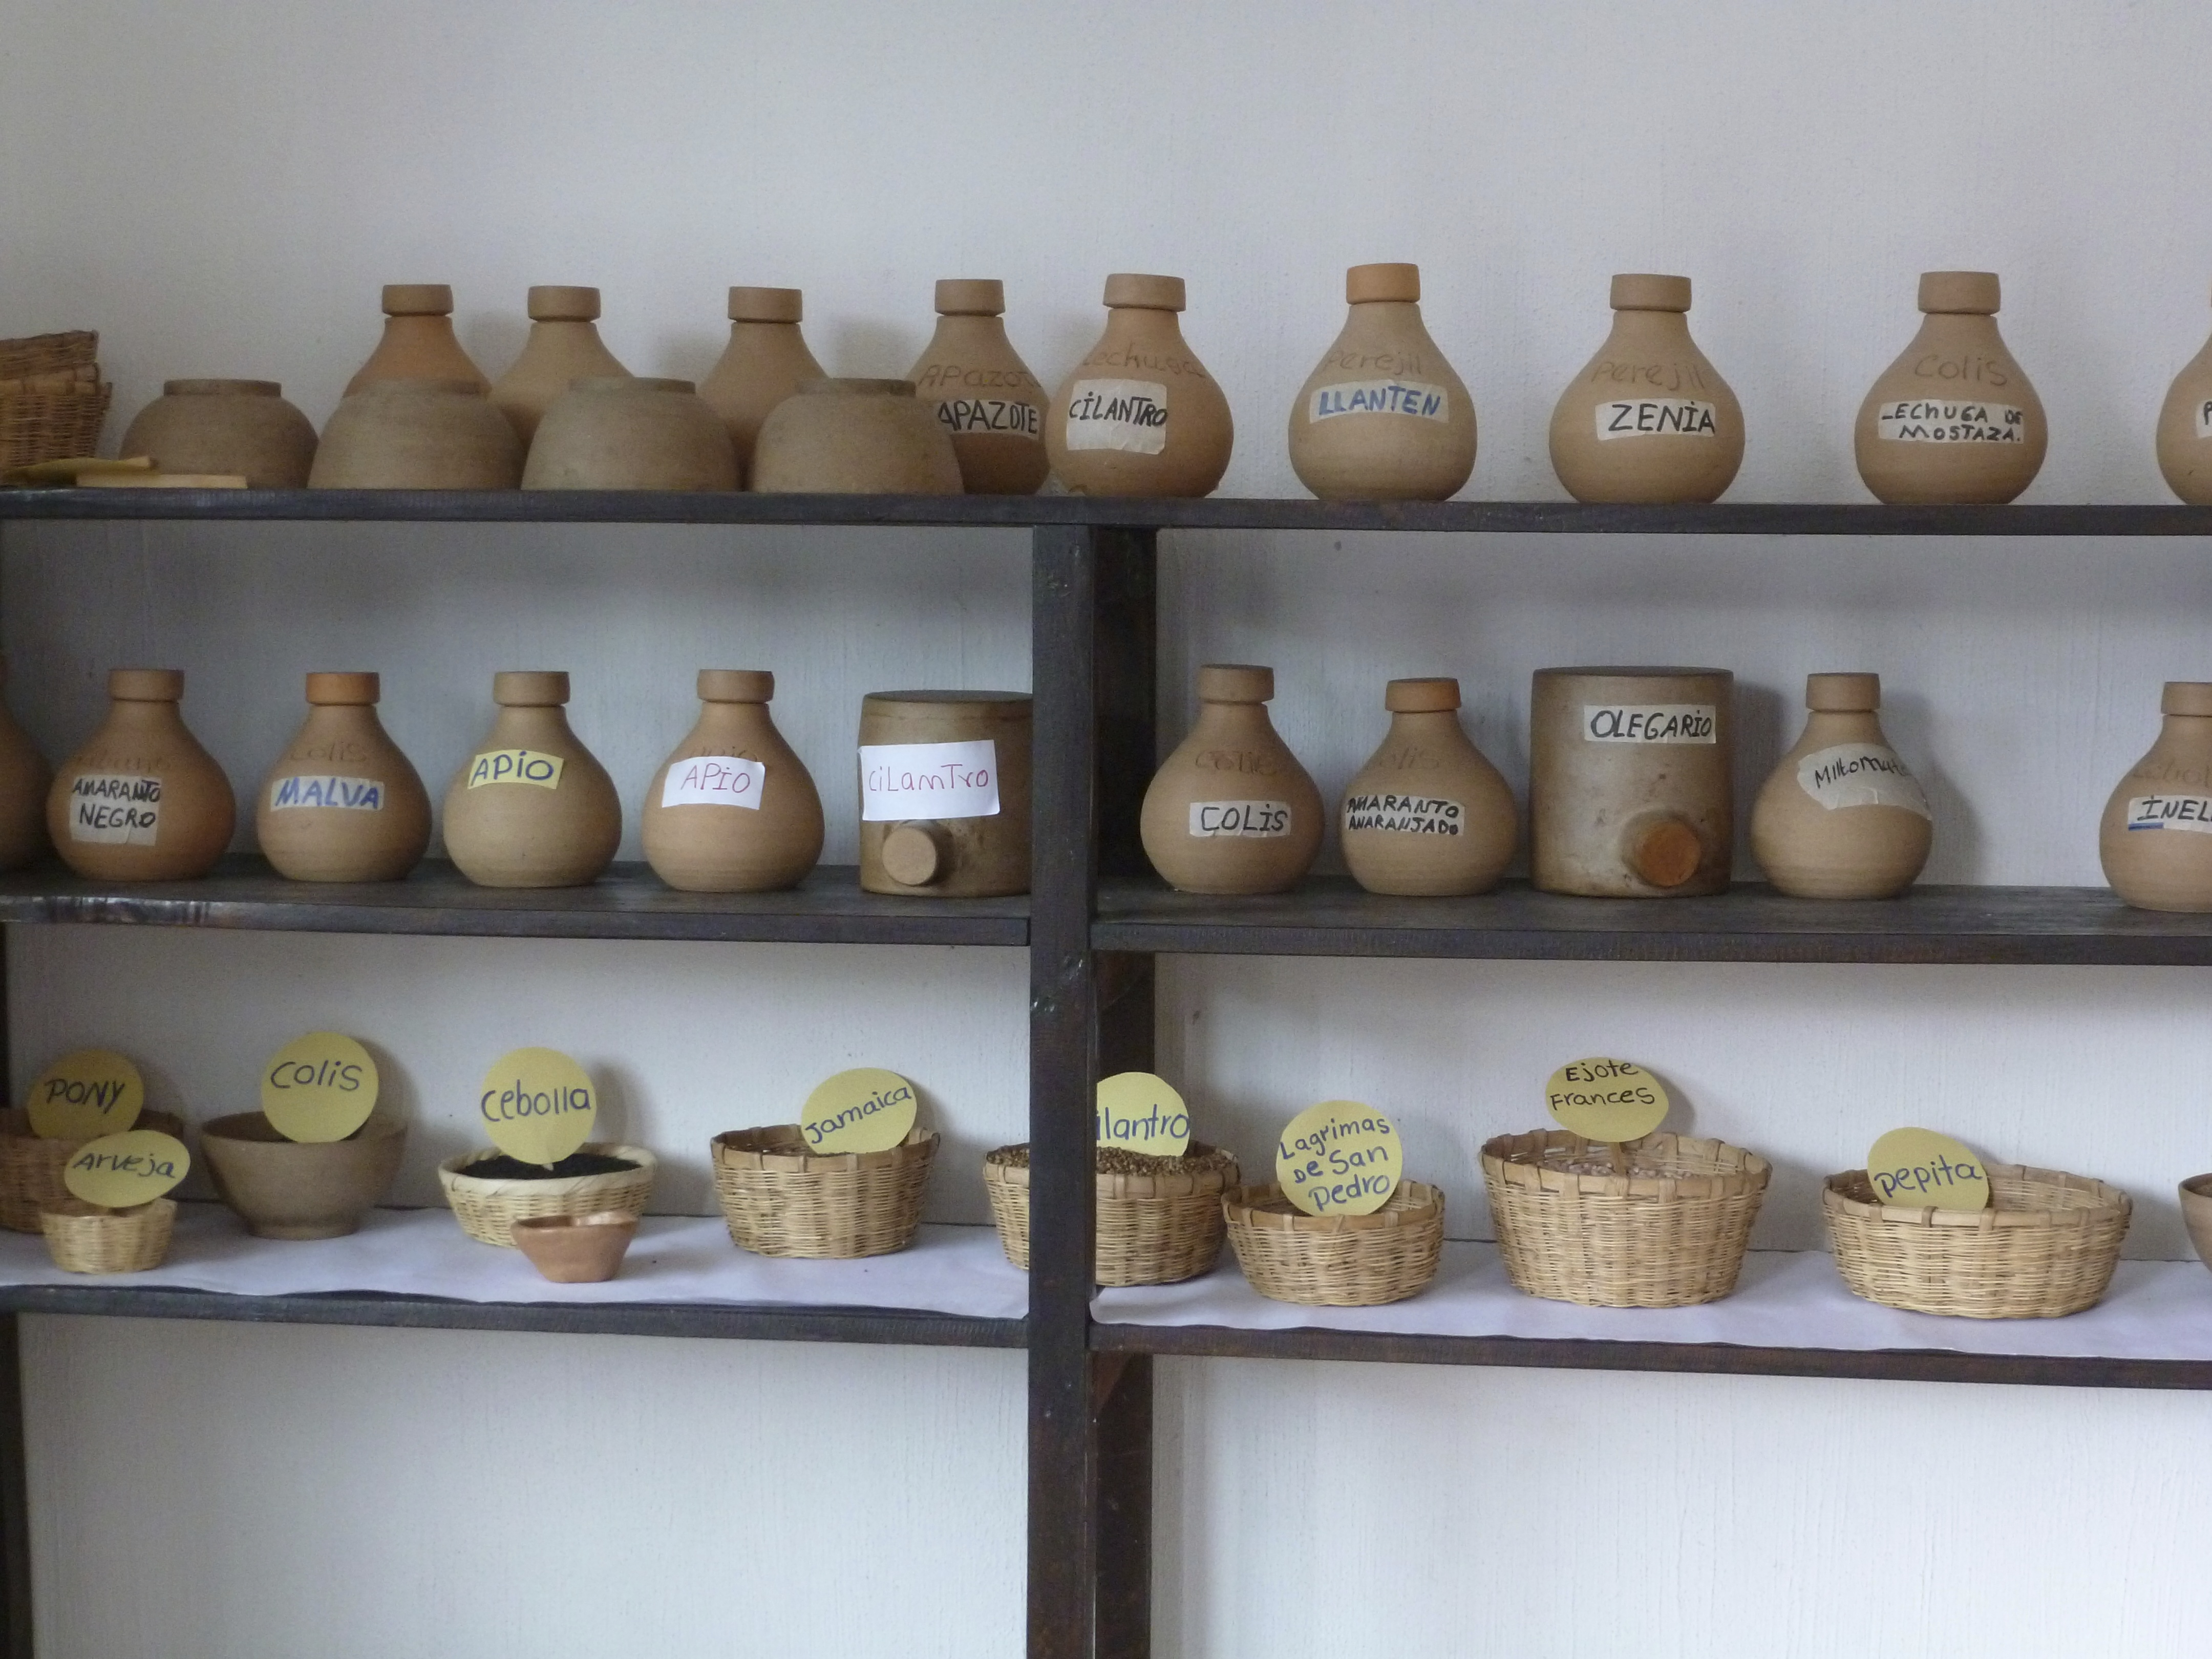
Associations
Guiding Questions:
What is the organizational history of each association?
How are organizations structured?
What are some of the challenges and benefits of an association?
How do associations connect to markets?

Slide 22
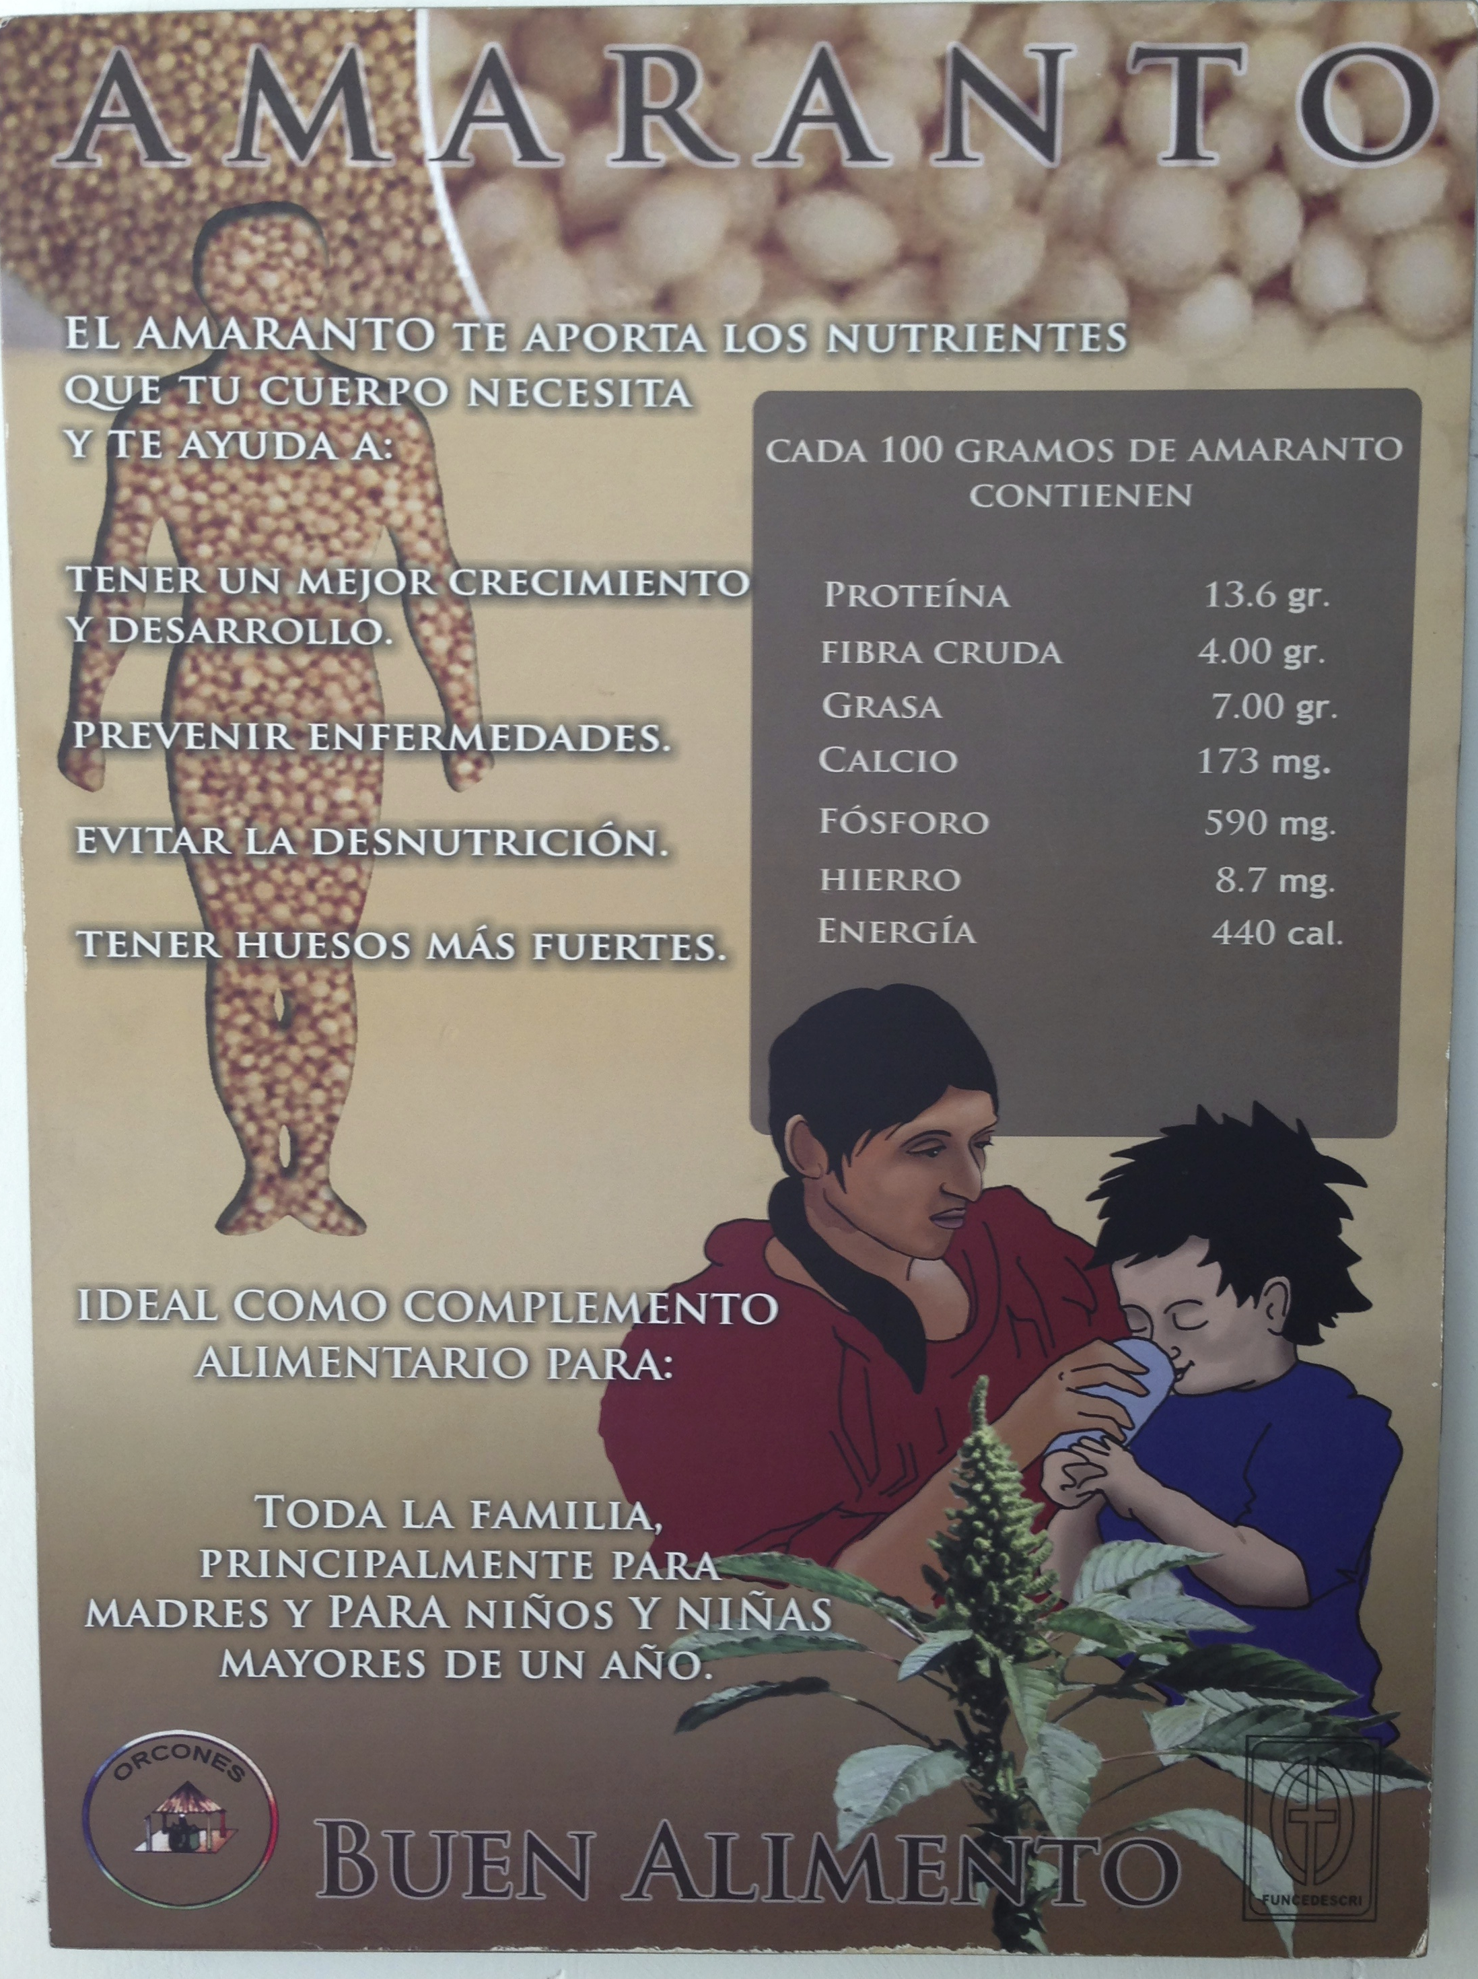
Benefits & Challenges
Benefits
Provide trainings & technical assistance, and facilitate intercambios
Connect small farmers to markets
Challenges
Finding capable leaders with sufficient agricultural and business knowledge
Long-term planning for sustainability
Case Studies
- Puente, in Mexico, uses the methodology of “intercambios”
- Intervida was successful with Amaranth but focused on sales only and lacked long term planning
- Qachuu Aloom has seed banks & test garden, offers training and holds cooking contests
- Kulbaalib Xechulub had community promoters to primarily encourage home consumption
- Chikach promotes amaranth production through vertical integration

Slide 23
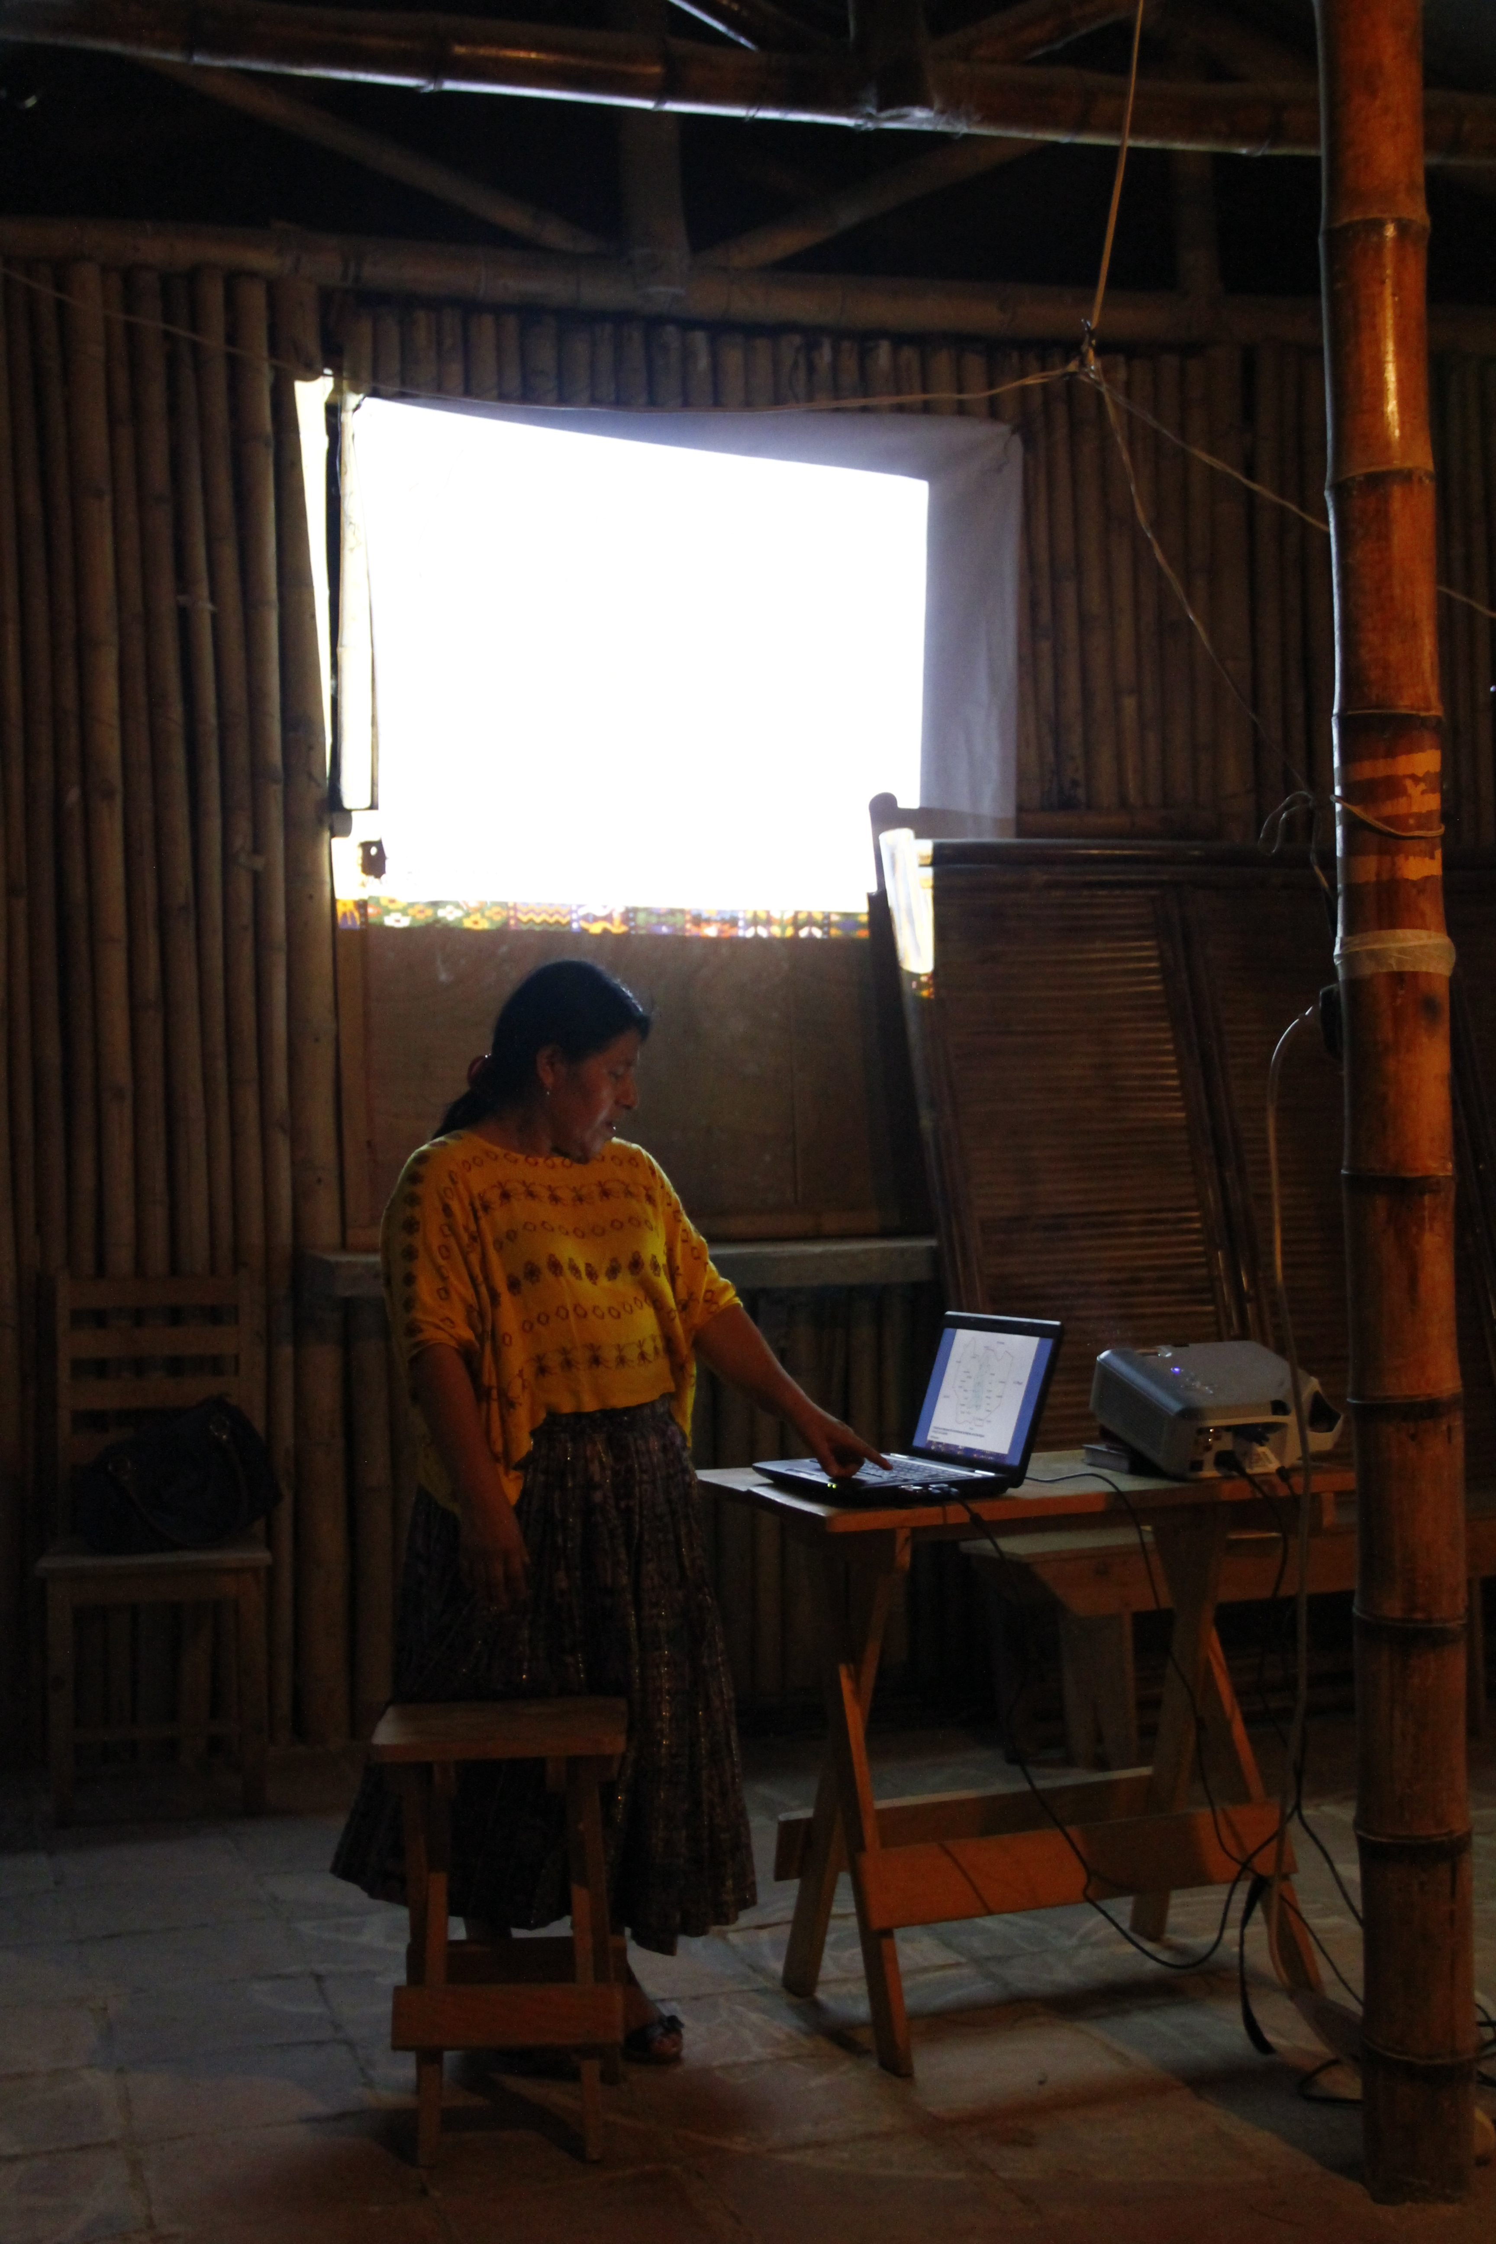
Associations: Best Practices
Create common goal
Understand what resonates with the community
Identify motivated and innovative leaders to bring together farmers
Focus on home consumption - #1 priority
Require a percentage to be consumed
Food preparation
Health/Nutrition education
Train Farmers
Agricultural practices
Seed selection

Slide 24
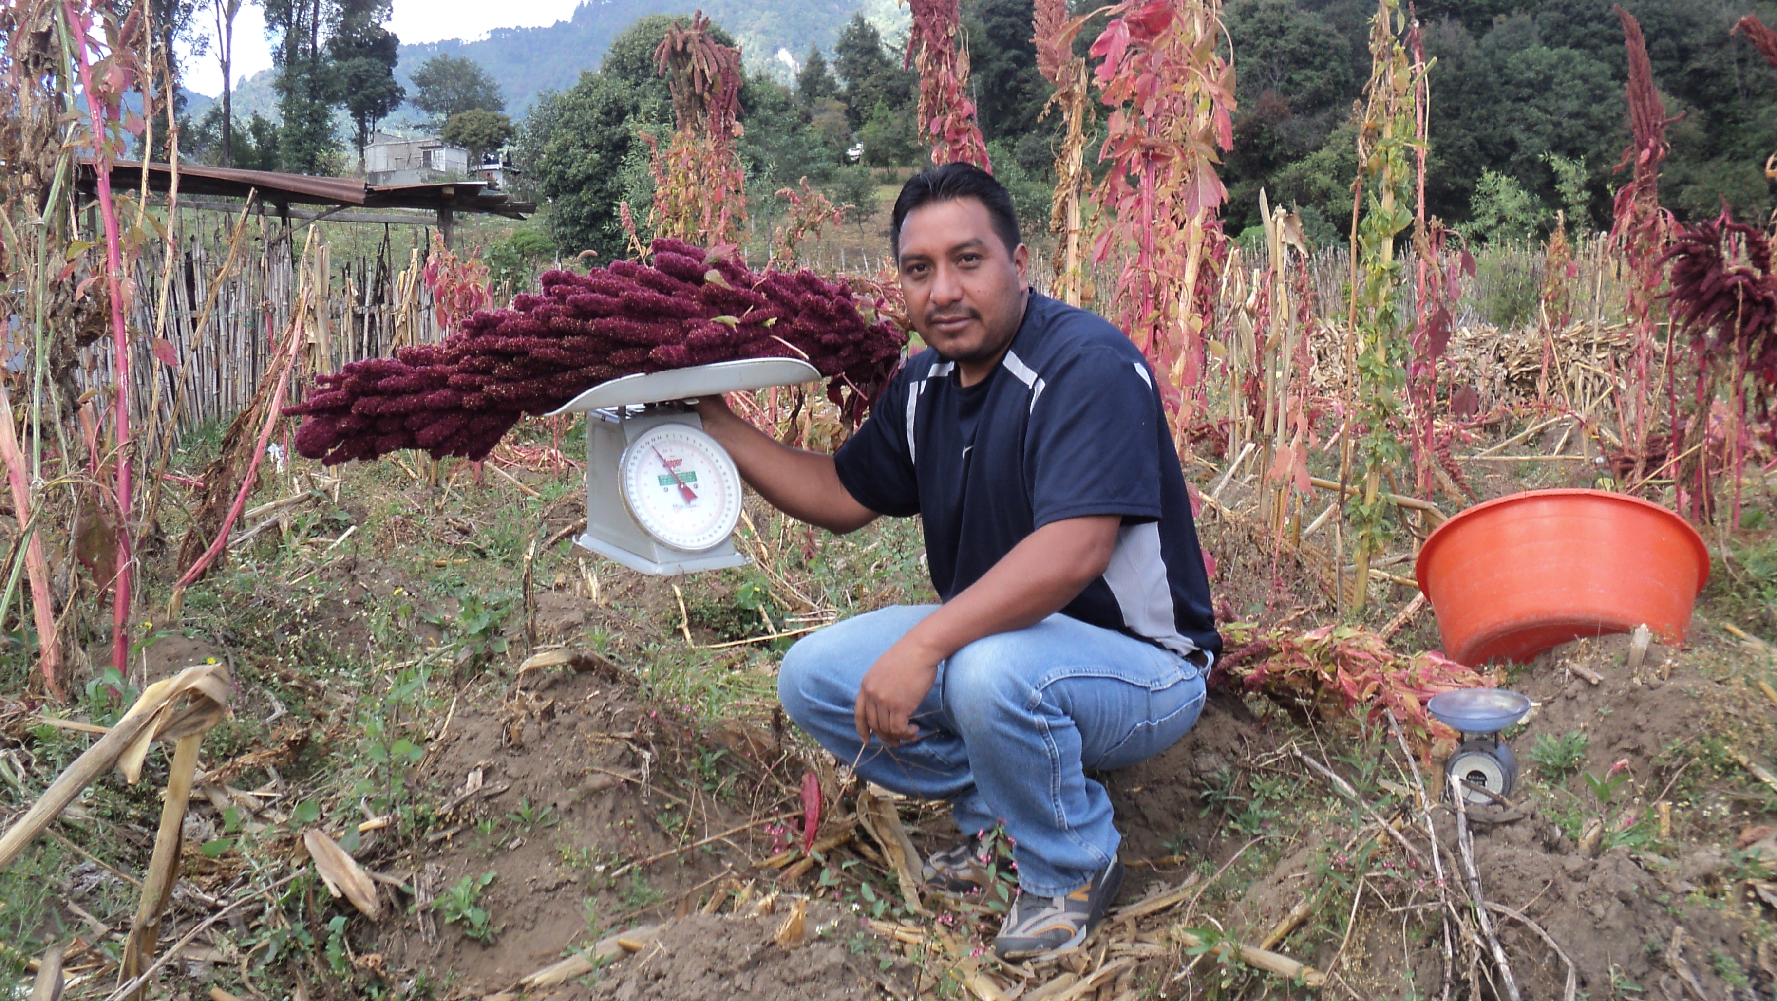
An Alternative to Associations
Entrepreneurs or Private Business
Many believe investing in entrepreneurs
leverages powerful economic incentives that
accelerates the go-to-market process.
CRS could harness this motivation through
Scholarships for entrepreneurs
Entrepreneurial development programs
Direct debt & equity investment
A program would need to ensure entrepreneurs
Consider farmers’ interest at forefront
Promote consumption & do training
Connect farmers to market at fair prices

Slide 25
Economics of Associations
Primary costs are procurement, member training
More research is needed on staffing & overhead expenses
Despite commercialization, all associations we visited were subsidized
Association Purchase Price
800Q - 1200Q per qq
Association Sale Price
3000Q per qq

Slide 26
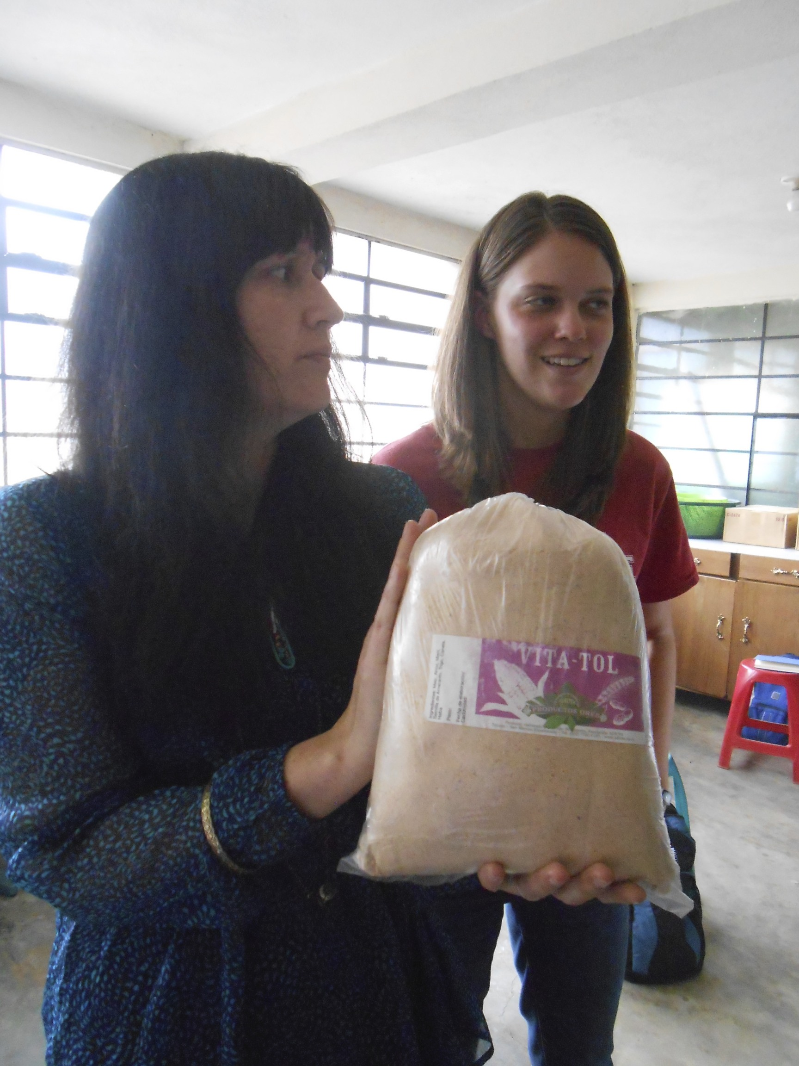
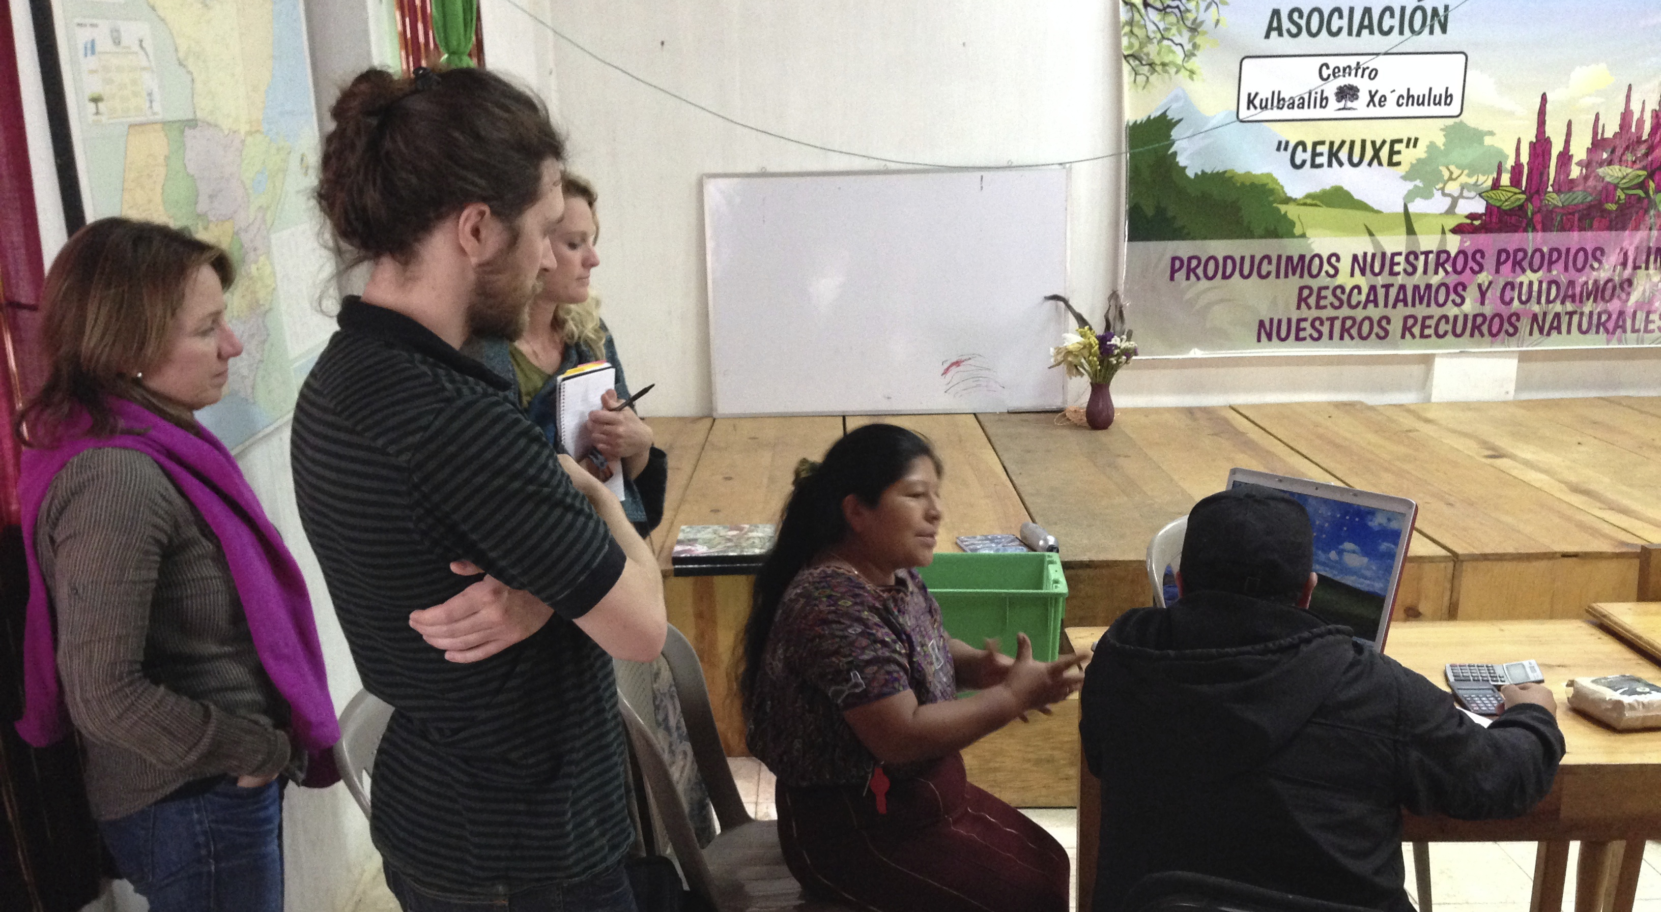
Key Take-Aways: Associations
The formation of a sustainable association is a long term process, which needs a clear path to economic independence
Strong, well-trained leaders make all the difference
Emphasis on commercialization; must be balanced with consumption
The community needs to have ownership of the association
They can capture more of the value chain with post-processing

Slide 27
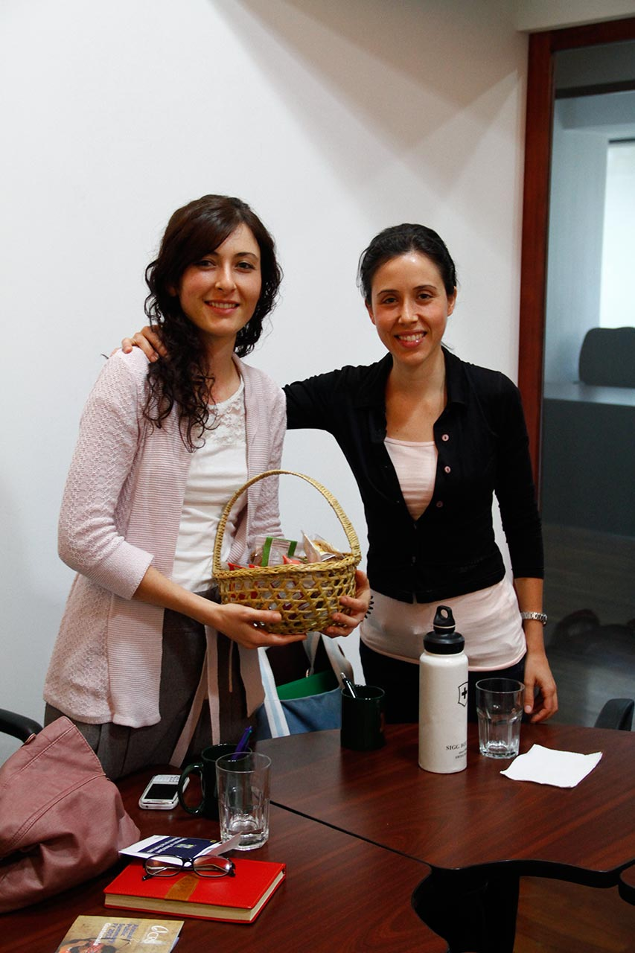
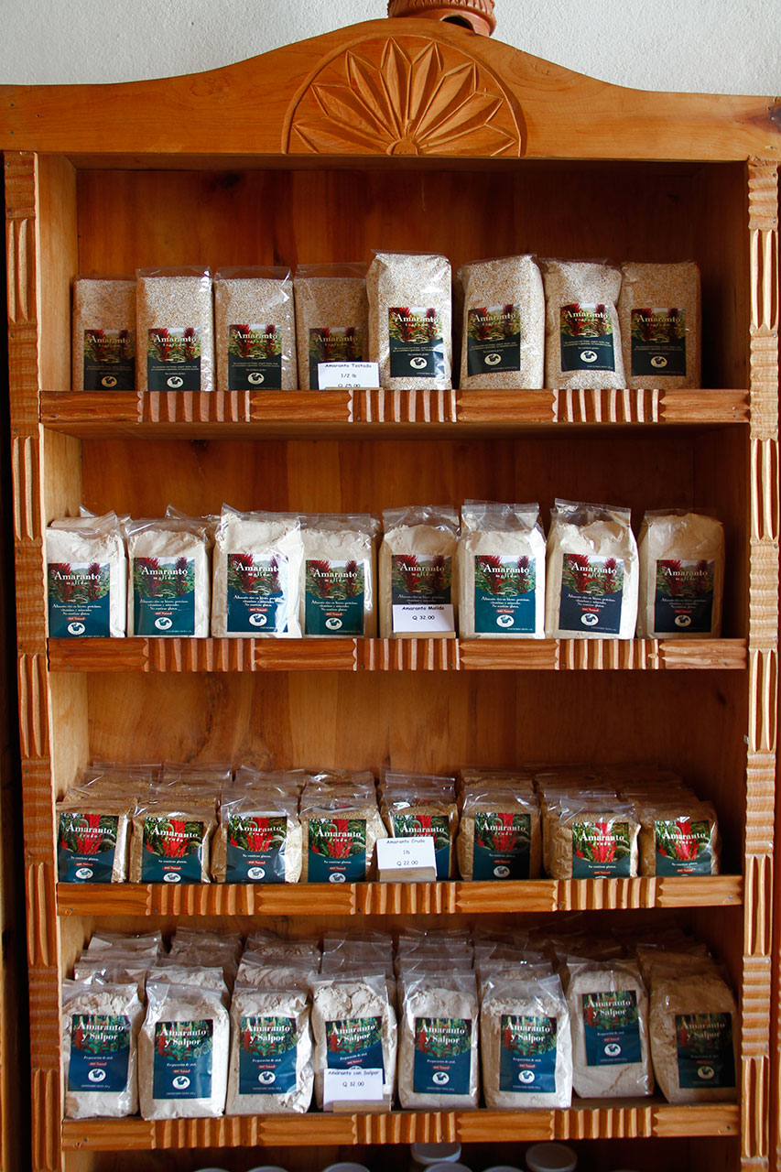
Bulk Buyers: Guatemala & Export
Guiding Questions:
How much amaranth do they buy and sell?
How much demand is there for amaranth and how is it changing?
Where do bulk buyers obtain their supply?
Are bulk buyers interested in new sources?
Bulk Buyers Interviewed
Artesano
Lula’s Oven
Chikach
Retailers including Super Verdura, Organica, Superb, others

Slide 28
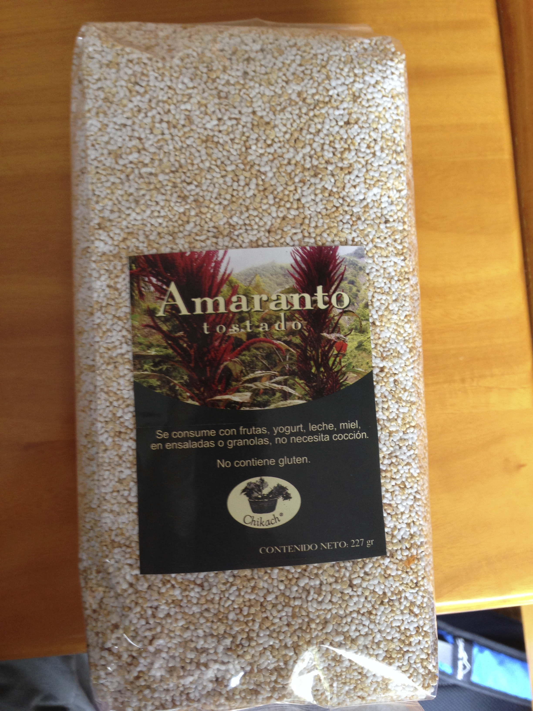
Bulk Buyers: Guatemala
Amaranto, not amaretto: When asked if they carried amaranth, larger supermarkets had no idea what it was -Exclusively health food stores carry it
Health food stores reported increasing demand and were optimistic about future growth
Some stores are selling bulk, while others are aiming to add value to amaranth by making ready-to-eat snacks

Slide 29

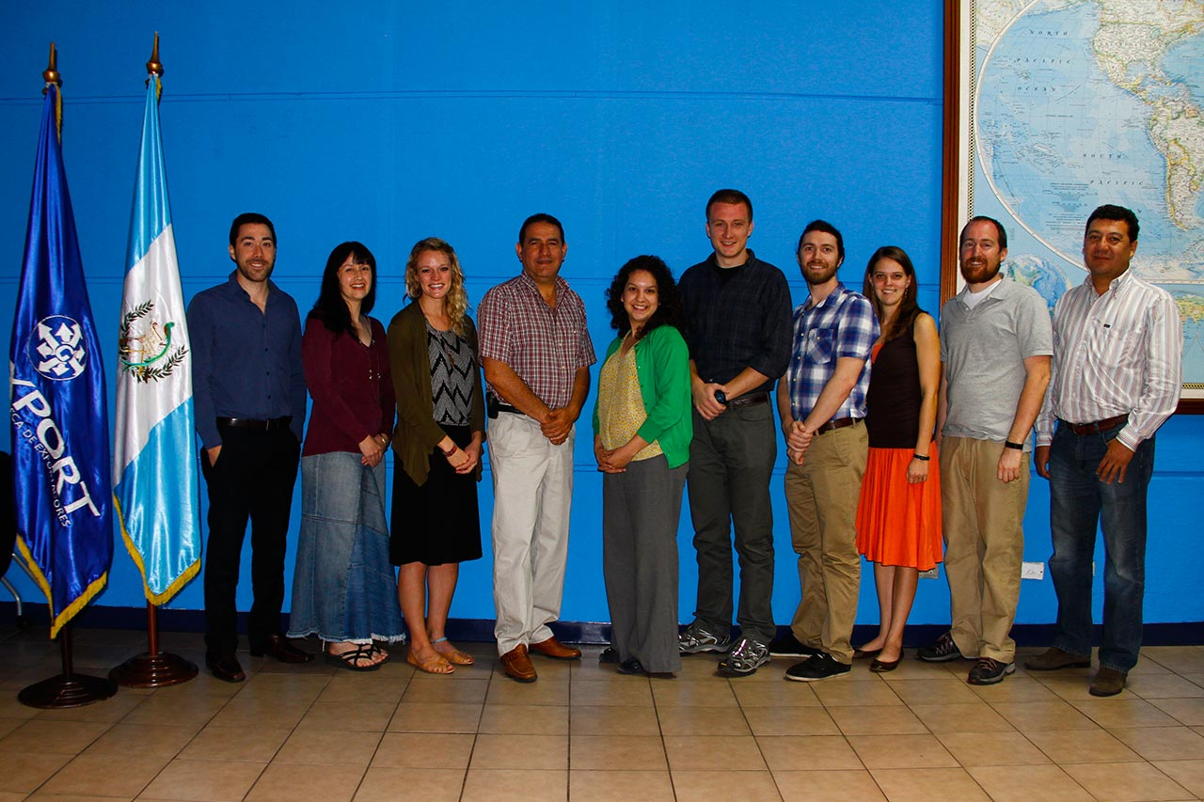
Bulk Buyers: Export
Currently, there is no exportation of Guatemalan
amaranth
AgExport has stated that groups have inquired about sourcing Guatemalan amaranth, indicating unmet demand
International prices are below Guatemala market averages which makes us doubtful about the profitability of exportation
Adequate supply would be a concern.
Some groups oppose exportation, in favor of focusing
on farmer’s consumption

Slide 30
Economics of Bulk Buyers
Bulk buyers mark up 80% to 130% for resale, depending on product.
Imported amaranth from Mexico is currently cheaper but of lower quality than local amaranth.
Guatemalan
Bulk Purchase Price
31Q per pound
Guatemalan
Retail Sale Price
60Q per pound
Mexican Import
Poporopo Bulk Price
Artesano buys
500 lb./month
at 15-17Q/lb.

Slide 31
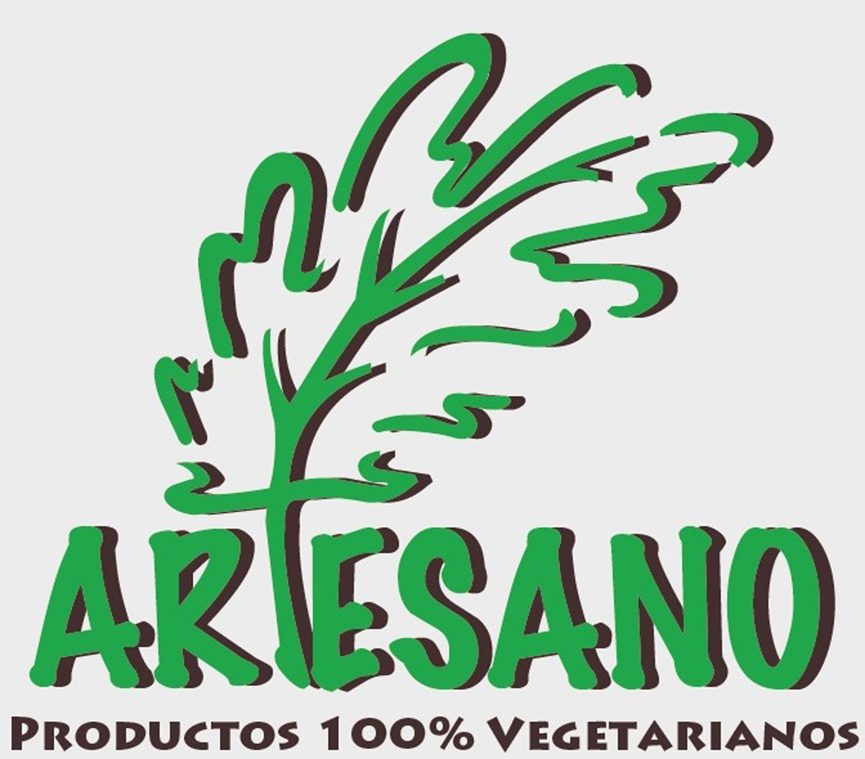
Key Take-Aways: Bulk Buyers
Observations:
1. Through creative partnerships (government, church, communities), demand can be boosted for the expand market
2. Mexican amaranth is likely the largest supply source in Guatemala City with a wholesale price of 15-17Q/lb.
3. There is excess demand for bulk Guatemalan amaranth – buyers cannot currently find all desired types and quality of amaranth (popped only)
4. Big potential upside if taken up by larger supermarket chains
Concerns:
Maintaining relationships between bulk buyers and amaranth associations
Obtaining a sufficient supply from small farmers in San Marcos

Slide 32


Customers
Guiding Questions:
Who is consuming amaranth domestically and internationally?
Why are they consuming amaranth? What do they value?
How much amaranth will they consume?
Facts About Customers
A significant contingent of buyers are foreigners (up to 50%)
Driving demand for amaranth in Guatemala City
“Eat Your Panqueques” -KL

Slide 33
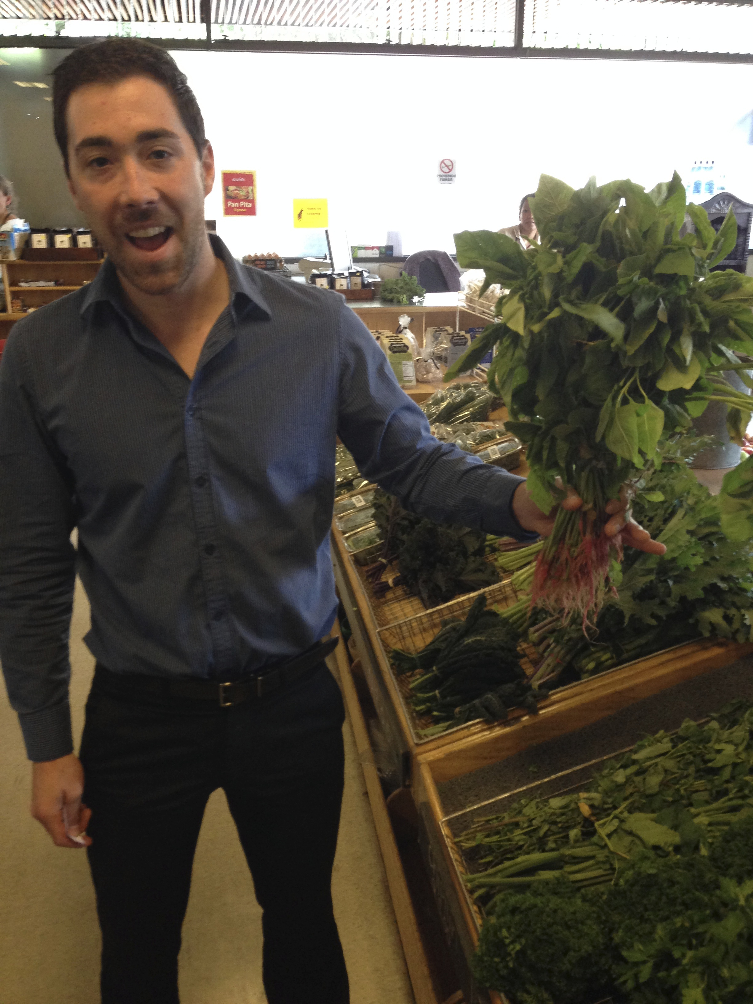
A Customer Profile
Like health food customers, amaranth buyers tend
to be wealthy, younger, and fitness-oriented
Some customers are driven by the gluten-free movement
Vegetarians and vegans
Religious motives (Seventh Day Adventist)
In Guatemala City, Mayan connection not particularly
relevant to customer

Slide 34
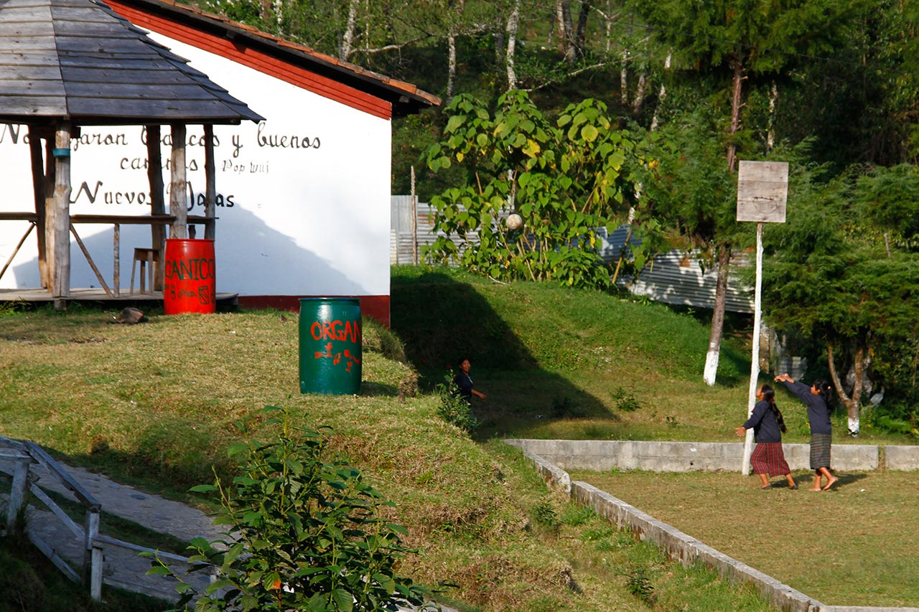
Additional Potential Customers
Potential for customers or bartering in local San Marcos markets, which can improve community nutrition
Potential for regional markets
Opportunity to supply to organizations such as schools, hospitals, and other public institutions

Slide 35
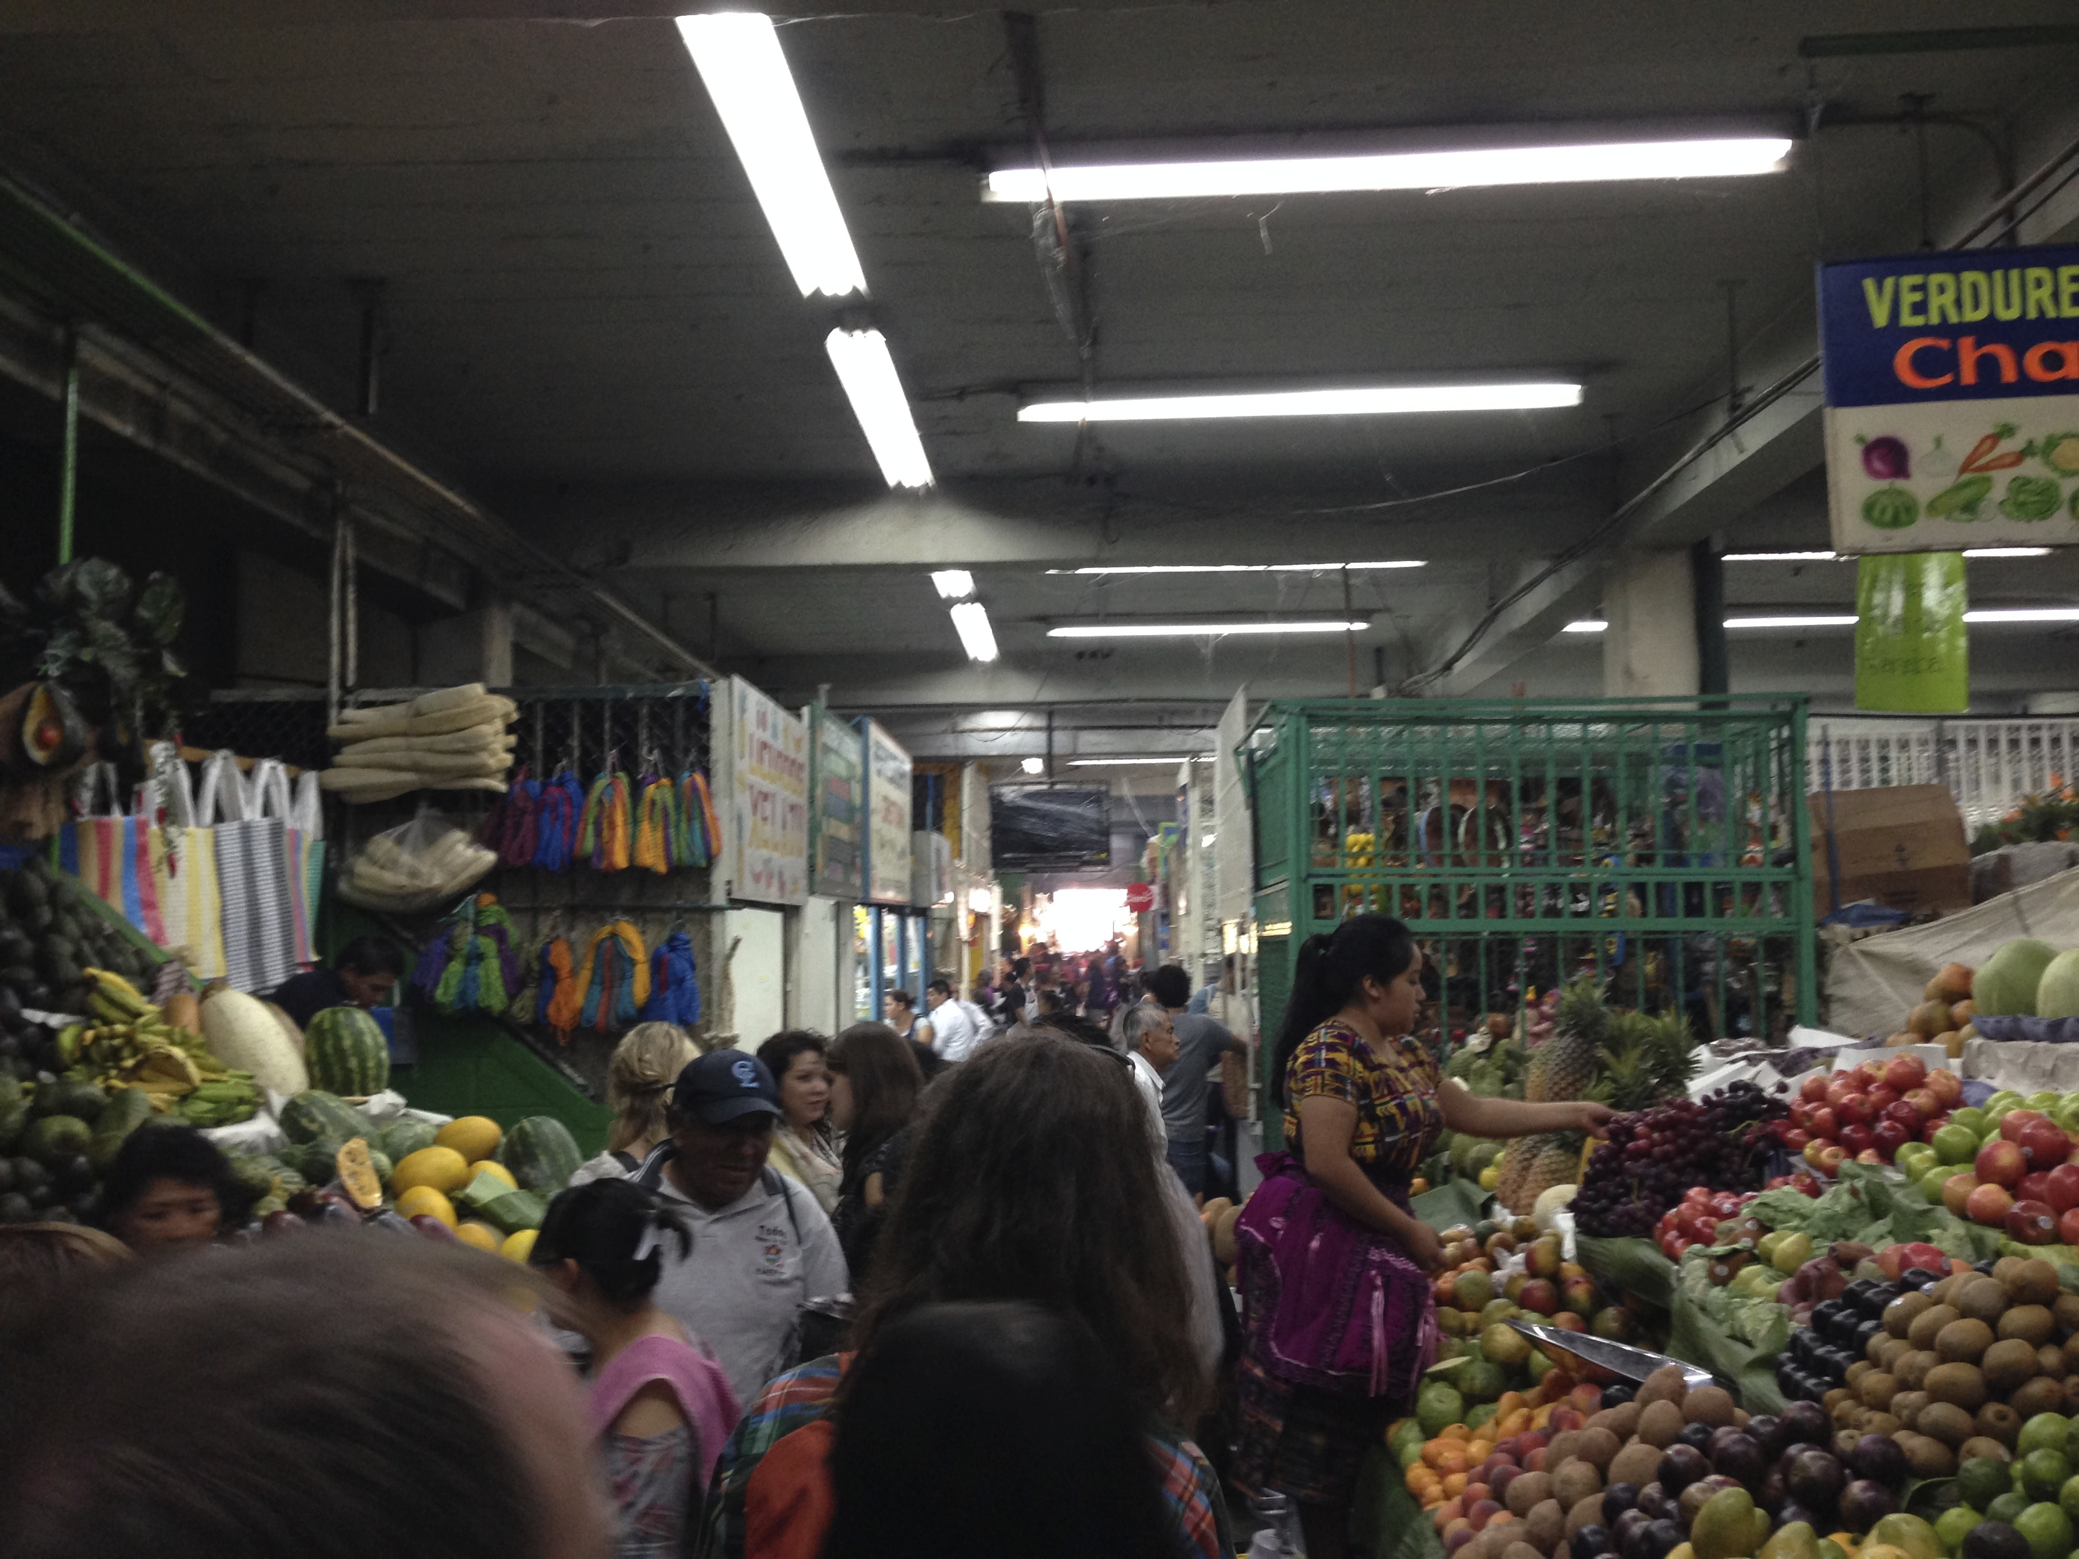
Economics of Customers
Customers will spend more for convenience, presentation
We suspect latent demand in the mid-market
Average Retail Prices
42Q per pound (Harina)
75Q per pound (Popped)
71Q per pound (Alegria)

Slide 36

Key Takeaways: Customers
Observations:
It’s a niche market—gluten-free, diet, perception of health—both
Guatemalans and expats buy and use it
People find out about amaranth because they are searching for gluten-free or other health trends, i.e. weight loss, high protein, amino acids
3. Needs preparation – popped is the most popular, tasty snacks important
Demand is increasing with limited marketing
Room for growth (e.g. supermarkets)
Concerns:
Health food trends come and go
If demand grows too much, may make it unreasonable for farmers to consume (e.g. quinoa)

Slide 37
Facts, Figures, Analysis

Slide 38




Sale Prices

Slide 39
Sale Prices
 | POPPED (POPOROPO)
 | Source | Lb | GTQ | GTQ/lb | Averages
End | Artesano Store | 0.50 | 38.00 | 76.00 | 75.20
 | Super Verduras | 0.50 | 38.00 | 76.00
 | Artesano Store | 0.25 | 20.00 | 80.00
 | Super Verduras | 0.25 | 20.00 | 80.00
 | Kuchub'al (Atitlan) | 0.50 | 32.00 | 64.00
Middle | Qachuu Aloom | 0.50 | 25.00 | 50.00 | 48.50
 | Qachuu Aloom | 0.25 | 15.00 | 60.00
 | Chikach | 0.50 | 25.00 | 50.00
 | Kulb'aalib' Xe'chulub' | 0.50 | 17.00 | 34.00

Slide 40
Sale Prices (cont.)
 | FLOUR (HARINA)
 | Source | Lb | GTQ | GTQ/lb | Averages
End | Super Verduras | 0.7 | 31.10 | 43.38 | 41.69
 | Kuchub'al (Atitlan) | 1.0 | 40.00 | 40.00
Middle | Chicakh | 1.0 | 32.00 | 32.00 | 22.50
 | Qachuu Aloom | 1.0 | 20.00 | 20.00
 | Qachuu Aloom | 0.5 | 10.00 | 20.00
 | Kulb'aalib' Xe'chulub' | 1.0 | 18.00 | 18.00
 | ALEGRIA
 | Source | Bars | GTQ | GTQ/lb | Averages
End | Artesano | 3 | 15 | 75.76 | 70.71
 | Super Verduras | 3 | 13 | 65.66
Mid | Kulb'aalib' Xe'chulub' | 1 | 2.00 | 30.30 | 30.30
 | Kulb'aalib' Xe'chulub' | 2 | 4.00 | 30.30

Slide 41
Value Chain Breakdown
Farmer
Association
Retail
per pound | Farmer | Value added | Aggregator | Value added | Resale
Cruda | GTQ 10.00 | 120% | GTQ 22.00 | - | -
Harina | - | 125% | GTQ 22.50 | 85% | GTQ 41.69
Poporopo | - | 385% | GTQ 48.50 | 55% | GTQ 75.20
Alegria | - | 203% | GTQ 30.30 | 133% | GTQ 70.71
Notes:
-lots of value in aggregator: want to (1) have the aggregator be pro-farmer, or (2) help farmer move into this portion of the value chain

Slide 42
Small Farmer: Amaranth vs. Corn
 | AMARANTH | CORN
INCOME
Sale Price (GTQ/qq) | 1000 | 150
Yield (qq/cuerda) | 1.5 | 3
Amt. Cultivated (cuerdas) | 1 | 1
% Consumed | 60% | 60%
Total Income | 600 GTQ | 180 GTQ

Slide 43
Start-Up Costs
Small Farmer
Land
Equipment
Baskets
Tarp
Basic hand tools
Irrigation system components
Strainer/sifter
Storage containers
Association
Buildings/storage space
Equipment
Stove
Popping equipment
Mill
Packaging equipment

Slide 44
Projected Income: Small Farmer
Per harvest | Worst Case | Typical | Best Case
INCOME
Sale Price (GTQ/qq) | 800 | 1000 | 1200
Yield (qq/cuerda) | 1.25 | 1.5 | 2
Amt. Cultivated (cuerdas) | 1 | 1 | 1
% Consumed | 60% | 60% | 60%
Total Income | 400 GTQ | 600 GTQ | 960 GTQ
EXPENSES
Seed | 100 GTQ | 62 GTQ | 24 GTQ
Fertilizer | 250 GTQ | 50 GTQ | - GTQ
Irrigation | 16 GTQ
Total Expenses | 366 GTQ | 112 GTQ | 24 GTQ
PROFIT | 34 GTQ | 488 GTQ | 936 GTQ
PROFIT MARGIN | 9% | 81% | 98%
Notes:
Takeaways:
-give general view of economic situation
-tool for CRS to use in future development
*per year, per cuerda, per harvest consumption rate

Slide 45
Projected Income: Association
Per year | Worst Case | Best Case
INCOME
% Popped | 50% | 50%
% Flour | 25% | 25%
% Alegria | 25% | 25%
Popped (poporopo)
Sale Price (GTQ/lb) | 48.50GTQ | 48.50GTQ
Amt. Sold (lb) | 5000 | 5000
Flour (harina)
Sale Price (GTQ/lb) | 22.50GTQ | 22.50GTQ
Amt. Sold (lb) | 2500 | 2500
Alegria
Sale Price (GTQ/lb) | 30.30GTQ | 30.30GTQ
Amt. Sold (lb) | 2500 | 2500
# Members | 100 | 100
Membership fees (GTQ/yr) | 25 | 25
Total Income | 377,008 GTQ | 377,008 GTQ
Notes:
Does not include other alegria ingredients
Does not include a number of expenses: CRS can include on a case-by-case basis
Most associations are working with some grants

Slide 46
Projected Income: Association
Per year | Worst Case | Best Case
EXPENSES
Units Sold (assume 1 lb) | 10,000 | 10,000
Purchase Price (GTQ/qq) | 1,200.00GTQ | 800.00GTQ
Purchase Amt. (qq) | 100 | 100
Purchase Expense | 120,000 GTQ | 80,000 GTQ
Packaging | 1,155 GTQ | 1,155 GTQ
Transportation | 5,000 GTQ | 3,000 GTQ
Training | 36,000 GTQ | 36,000 GTQ
Labor | add | add
Taxes | 64,091 GTQ | 64,091 GTQ
Overhead
License (depreciated 3 yr.) | 2,667 GTQ | 2,000 GTQ
Lab Fees | 400 GTQ | 200 GTQ
Popper (depreciated 3 yr.) | 4,167 GTQ | 4,167 GTQ
Building Maintenance | add | add
Utilities | add | add
Marketing | add | add
Total Expenses | 233,479 GTQ | 190,613 GTQ
PROFIT | 143,528 GTQ | 186,395 GTQ
PROFIT MARGIN | 38% | 49%
Notes:
Does not include other alegria ingredients
Does not include a number of expenses: CRS can include on a case-by-case basis
Most associations are working with some grants

Slide 47
Projected Income: Association
Per year | Worst Case | Best Case
INCOME
% Popped | 50% | 50%
% Flour | 25% | 25%
% Alegria | 25% | 25%
Popped (poporopo)
Sale Price (GTQ/lb) | 48.50GTQ | 48.50GTQ
Amt. Sold (lb) | 5000 | 5000
Flour (harina)
Sale Price (GTQ/lb) | 22.50GTQ | 22.50GTQ
Amt. Sold (lb) | 2500 | 2500
Alegria
Sale Price (GTQ/lb) | 30.30GTQ | 30.30GTQ
Amt. Sold (lb) | 2500 | 2500
# Members | 100 | 100
Membership fees (GTQ/yr) | 25 | 25
Total Income | 377,008 GTQ | 377,008 GTQ
Per year | Worst Case | Best Case
EXPENSES
Units Sold (assume 1 lb) | 10,000 | 10,000
Purchase Price (GTQ/qq) | 1,200.00GTQ | 800.00GTQ
Purchase Amt. (qq) | 100 | 100
Purchase Expense | 120,000 GTQ | 80,000 GTQ
Packaging | 1,155 GTQ | 1,155 GTQ
Transportation | 5,000 GTQ | 3,000 GTQ
Training | 36,000 GTQ | 36,000 GTQ
Labor | add | add
Taxes | 64,091 GTQ | 64,091 GTQ
Overhead
License (depreciated 3 yr.) | 2,667 GTQ | 2,000 GTQ
Lab Fees | 400 GTQ | 200 GTQ
Popper (depreciated 3 yr.) | 4,167 GTQ | 4,167 GTQ
Building Maintenance | add | add
Utilities | add | add
Marketing | add | add
Total Expenses | 233,479 GTQ | 190,613 GTQ
PROFIT | 143,528 GTQ | 186,395 GTQ
PROFIT MARGIN | 38% | 49%
Notes:
Does not include other alegria ingredients
Does not include a number of expenses: CRS can include on a case-by-case basis
Most associations are working with some grants

Slide 48
Summary

Slide 49
Our Approach:
GOALS: Understand Our Beneficiaries &
Trace the Guatemalan amaranth value chain
Families / Individual Consumption
Small Scale Farmers
Associations (Organizers)
Bulk Buyers (Local or Export)
Customers

Slide 50
Initial Findings
Conclusion #1
Amaranth is a viable intervention for addressing malnutrition and improving livelihoods
Conclusion #2
The critical factors are seed selection, technical training, dietary change and strong organizational structure.
Conclusion #3
The critical gap in the value chain is at the association/organizer level.
Conclusion #4
Significant value creation and capture can happen at the association/organizer level.

Slide 51
Next Steps: Deliverables
Business Plan for Small-Scale Farmers
Market Study
Looking for feedback on key components to include
Need to discuss target farmers
Goal – rough draft within 3 weeks; receive CRS feedback; final draft end of April
Can focus broadly or narrow on a specific area market
Would like to work with Miguel, CRS Value Chain
Goal – rough draft within 3 weeks; receive CRS feedback; final draft end of April

Slide 52

Ideas to Explore…
Supplying to CSR – oriented companies
Tortrix
Cliff….Alegria Cliff bar?
At what supply level would export become viable?
More public-sector purchase opportunities?
Strategic alignment with the private sector pact?
Additional amaranth products?

Slide 53

Discussion Time

Slide 54
Appendix

Slide 55
How We Broke Down the Project
Individual/Family Demand Level
Will people eat it? Buy it? Value it?
Small Farmer Production Level
How can we convince risk-averse farmers to adopt?
Local Market Level
Is there a business case to bring amaranth to market? Is there enough opportunity? What does it take to compete?
International Market Level
Is export viable? Does it help or hinder the project goals?

Slide 56
Initial Findings
Supporting amaranth cultivation in rural communities is a viable strategy to address malnutrition and improve standards of living, by forming the cornerstone of a nutrient-rich and economically attractive value chain.
Conclusion #1
In the cases we examined, the factors most critical to the success of an amaranth project include seed selection & technical training, dietary behavioral change programs, strong organization led by well-trained leadership, and an eventual path to market.
Conclusion #2
Our value chain analysis revealed a critical gap at the association/organizer level, which may prevent small farmers from accessing markets. We believe this is gap creates a clear opportunity for CRS intervention.
Conclusion #3
Significant value creation & capture happens at the association/organizer level of the value chain. After farmers have been successfully connected to markets, a good next step would be supporting them to move further up the value chain into these value-added activities.
Conclusion #4

Slide 57

Scope of Work
Client: Catholic Relief Services (CRS), Guatemala
Funding: CRS 6-year Title II Grant (2012-2018)
Title II Project Goals
Reduce chronic malnutrition
Improve health environment
Increase agricultural production
Title II Project Activities
Distribute food
Strengthen community environment
Promote amaranth cultivation
Connect to markets
BOTFL Team Deliverables
Business plan for a small producer and producer organization for national sales
Characterize the current state of the local & international amaranth market

Slide 58



It’s okay to have a good time…
Antigua, Atitlan, Volcanoes

Slide 59


Amaranth: The Mayan Superfood - UPDATE
Former staple destroyed by Spanish Conquistadors -1500s
Grain W/ 15% Protein & Key Amino Acids
Drought Tolerant & Adaptable
Grind into Flours – Maintain Taste w/ 75%mix
Attractive Market Price for Farmers
C4 Plant
Notes:
Teaching notes should encourage further research into the export/value chain of the banana, complexities thereof.

Slide 60
Our Sources
Expert Interviews
Braden Weldy – Indiana Farmer
Matt Maye - Gourmet Food Markets
Anna McKeever - Guatemalan Context
Hal Culbertson - Dietary Change
Matt Bloom – Design Thinking Expert
Pete Noll – El Puente Amaranth Project
Lulu’s Oven – Natural Snack Producers
Erik *** - US AID ***
Luis *** - CRS **TITLE**
NAME** - AgExport **
Sheryl *** - P4P, World Food Program
Harriet *** - Chikakh (sp?) Sustainable Supply Chains
NAME** - Quechoo Aloom ***sp?
Secondary Research
US AID Title II Grant Info
Amaranth Institute
Guatemalan Context
ECADI Reports
List other Stuff**

Slide 61

Current Export Picture
Guatemalan International Market Context
Exports – $9.2 Billion
Imports – $10.6 Billion
Export partners
US 40.2%, El Salvador 11.1%, Honduras 8%, Mexico 5.5%, Nicaragua 4.7%, Costa Rica 4.3%
Export Agriculture
12% sugar, 9% coffee, 6% bananas, 3.4% nutmeg*
Import partners
US 38%, Mexico 11.3%, China 7.4%, El Salvador 4.6%
Import Agriculture
Corn seed (1.28%) Wheat and Meslin (1.07%
Notes:
Challenge group to think about what the constraints are – want them looking at constraints that go beyond resources: social? principles? CRS has many.

Slide 62
Guatemalan Organizations
Organization | Web | About
Chikach | http://chikach.com/ | Brand of local/organic products
AGEXPORT | http://export.com.gt/en/#/inicio | Association of Guatemala Exporters
Artesano | http://www.artesano-inc.com/quienes-somos.php | Food company that provides 100% vegetarian products
Productos Integrales y Organicos | www.integralesyorganicos.site88.net
Compadores de mais
Asociación Ripalamax

Slide 63
Guatemalan Organizations
Organization | Web | About
Asociación Qachuu Aloom
Grupo Oxlajuj E
USAID | http://www.usaid.gov/where-we-work/latin-american-and-caribbean/guatemala

Slide 64
Issue Tree
PDF Link:
https://dl.dropboxusercontent.com/u/31826395/Issue%20Tree%202.pdf

Slide 65

Issue Tree

Slide 66

Quinoa
We consider Quinoa a model to learn from
Similarities:
Super Grain from South/Central America
Gluten-Free
Both eaten by pre-Columbian indigenousness Peoples
Notes:
Challenge group to think about what the constraints are – want them looking at constraints that go beyond resources: social? principles? CRS has many.

